Slide 1
Computer Networks
王廷
华东师范大学 软件工程学院
Email: twang@sei.ecnu.edu.cn
Office: 理科大楼B1116室

Slide 2
Chapter1：Introduction
  Uses of Computer Networks
  Network Hardware
  Network Software
  Reference Models
  Example Networks
  Network Standardization
  Metric Units

Slide 3
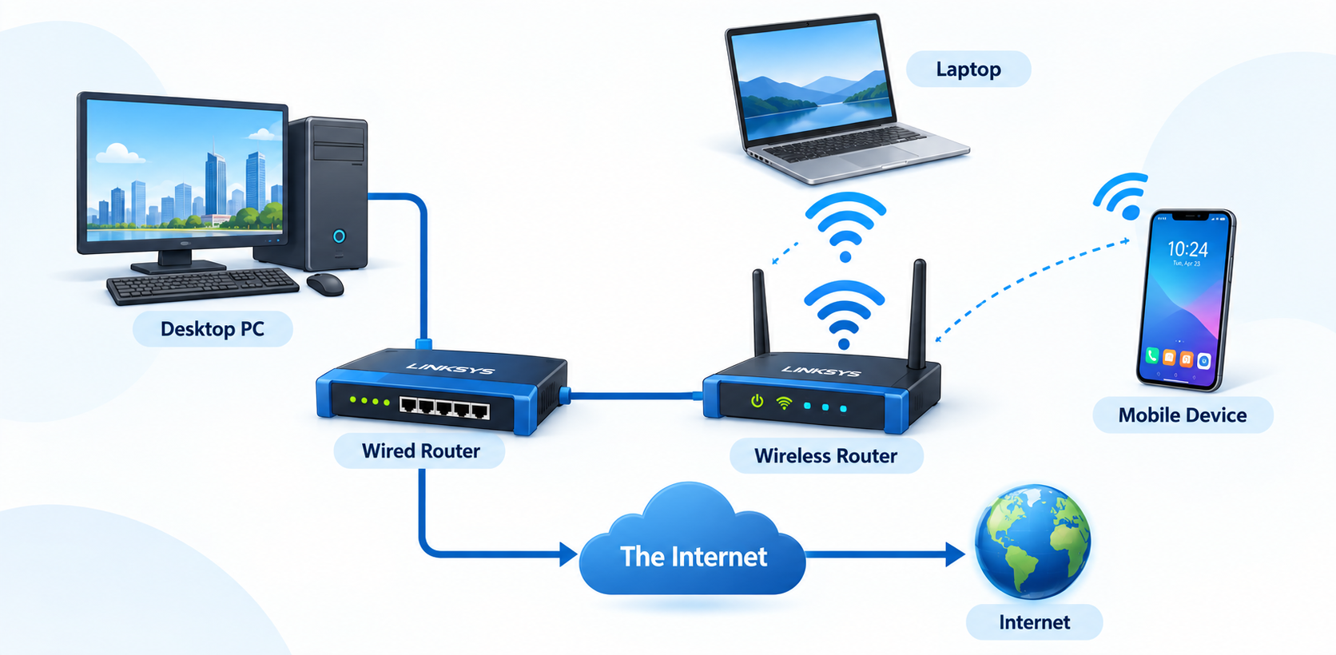

Network Example：A Typical Simple Scenario

Slide 4
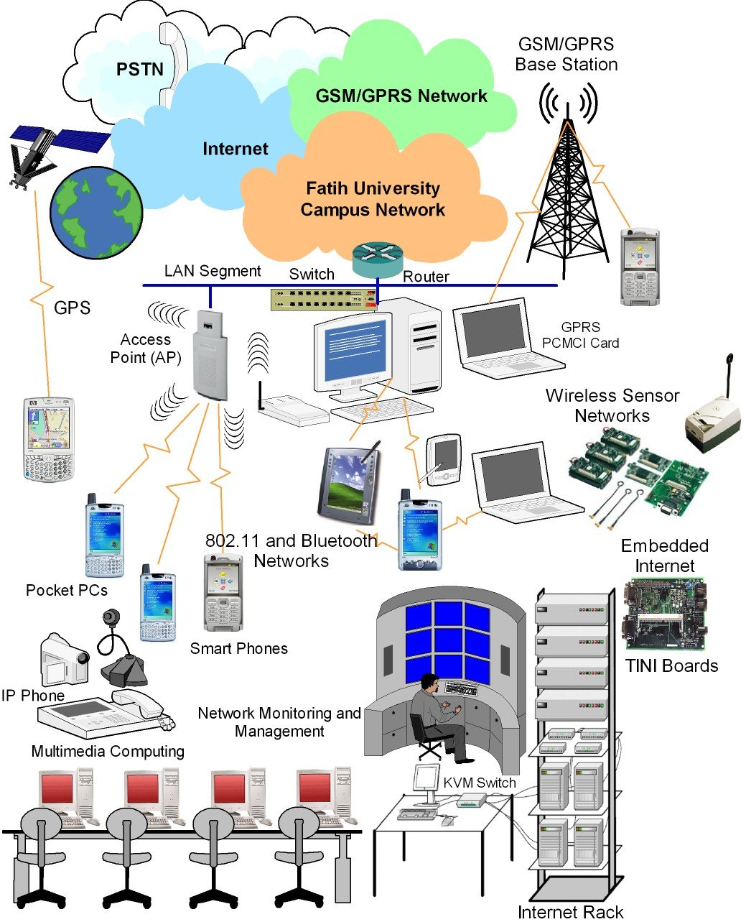
Network Example：Complex Scenario in Real World
现代网络环境不再是简单的点对点连接，而是一个集多种网络类型、接入技术和设备于一体的复杂系统。而且在持续演进。
不同网络类型
多样化接入技术
网络基础设施
网络通信协议

Slide 5
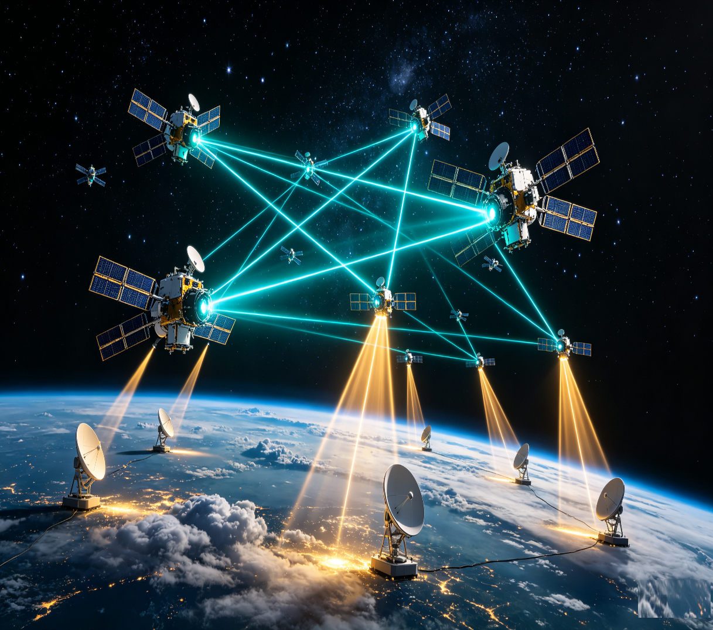
Network Example：Space Computing Network
中国国家政策
战略升级：“十五五”定位为航天强国核心引擎
“十四五”首次鼓励社会资本全面参与，“十五五”规划进一步将商业航天定位为建设航天强国的核心引擎。
政策落地：《行动计划》为航天发展指明发展路径
2025年发布《推进商业航天高质量安全发展行动计划》提出五大方向22项举措，构建了全链条政策支撑体系。
全球战略布局
美国：市场主导 + 政府采购双轮驱动
2015年《商业航天促进法》确立私营企业准入；2024 年国防部发布《国防部商业航天整合战略》；NASA向民营企业开放航天试验设施和技术专利；以NASA与军方订单培育SpaceX等龙头企业，抢先布局低轨星座频轨资源，确立全球市场主导地位。
欧盟：规则先行，构建自主空天体系
2025年出台《太空法案》商业航天统一监管框架，旨在统一欧盟27国碎片化航天规则，打造欧盟单一太空市场，降低对 Starlink 等境外巨型星座的依赖。典型代表：OneWeb。

Slide 6
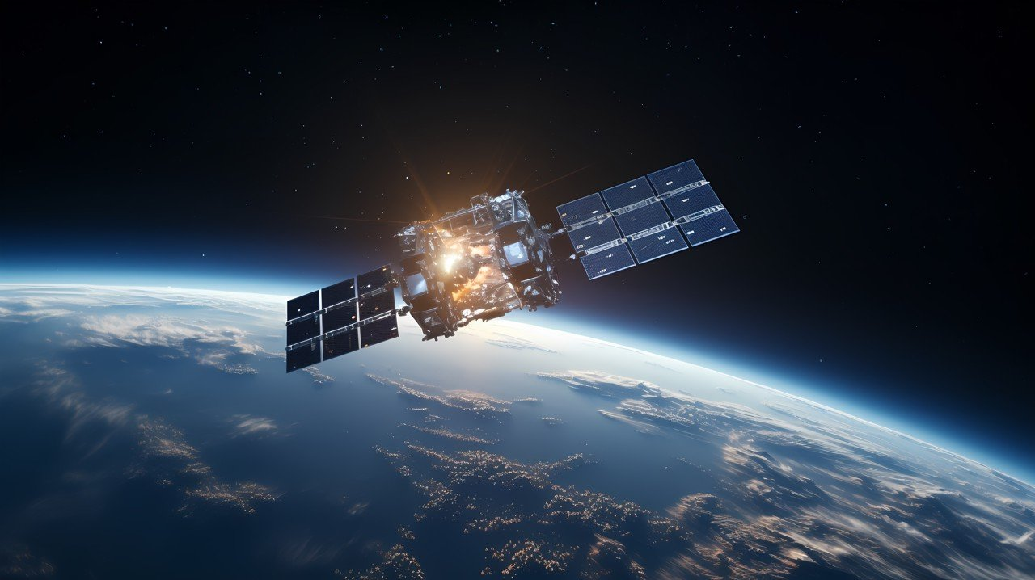
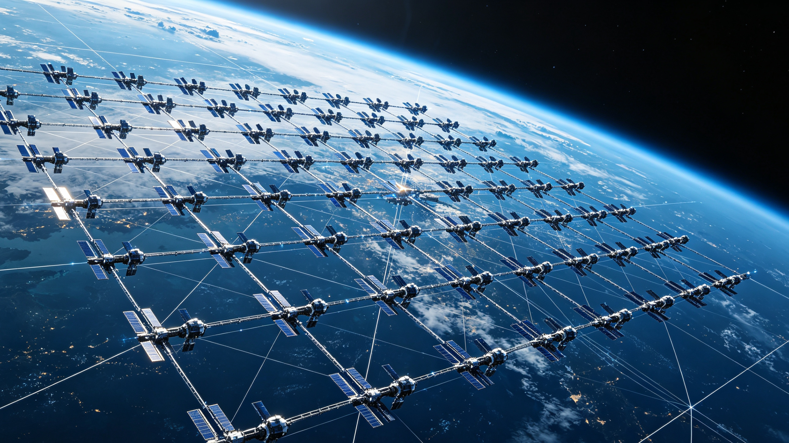
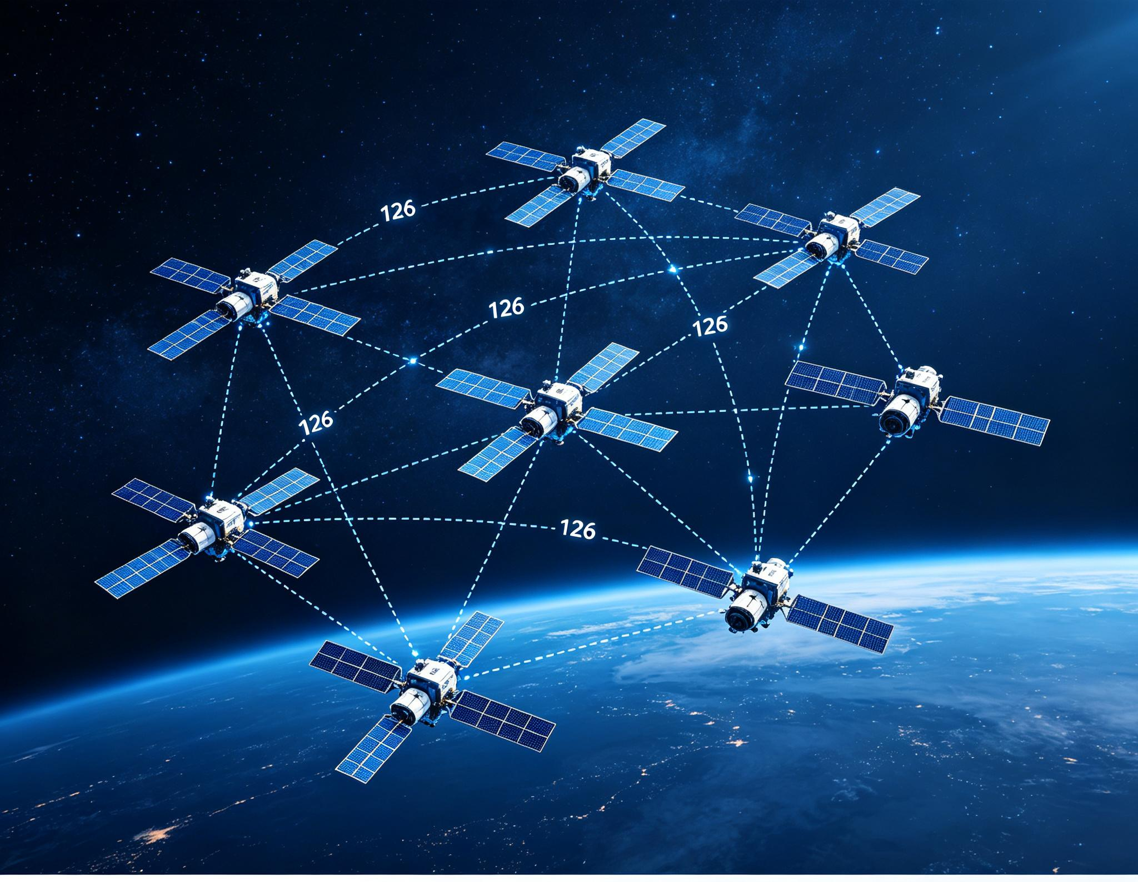

Network Example：Space Computing Network
01. 赛道格局：美国领跑与中国追赶
SpaceX 星链
中国星网 GW星座
垣信卫星 千帆星座
已部署卫星超 11,000 颗，覆盖全球150+国家，用户规模突破1200万，构建了成熟的低轨通信生态。
国家级旗舰工程，规划规模达 12,992 颗。截止2026年9月，在轨卫星195颗，稳步推进全球组网与基础设施建设。
商业航天新势力，规划 >15,000 颗卫星布局。在轨数量已达238颗，加速商业化应用场景的落地与验证。
02. 核心博弈：频轨资源的战略争夺
国际规则：ITU“先登先占”原则
频轨资源是不可再生的战略稀缺资源，申报窗口期竞争激烈，谁先完成部署，谁就掌握主动权。7-9-12-14 刚性履约规则。
中国行动：20万+资源申报，60+机构集结
2025年12月我国已向ITU申报20.3万颗卫星频轨资源，凝聚央国企、科研院校与商业航天合力，筑牢太空战略根基。

Slide 7

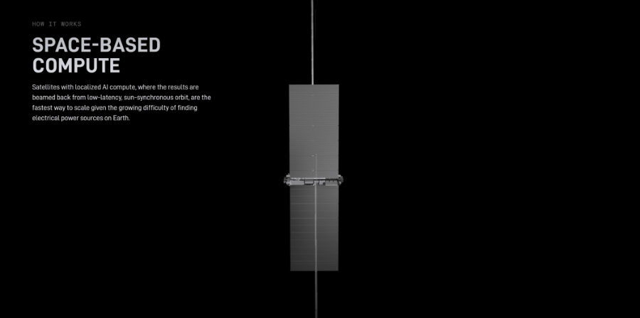
Network Example：Space Computing Network
2026年8月4日，SpaceX正式宣布：
携手英伟达推出轨道AI计算网络——Starmind（星际大脑）
SpaceX将完全基于NVIDIA的系统构建“数据中心级太空算力”
搭载NVIDIA Rubin GPUs & Vera CPUs
Starmind AI1卫星：高约30米、翼展75米
计算载荷峰值功率达250千瓦，平均功率约175千瓦

Slide 8
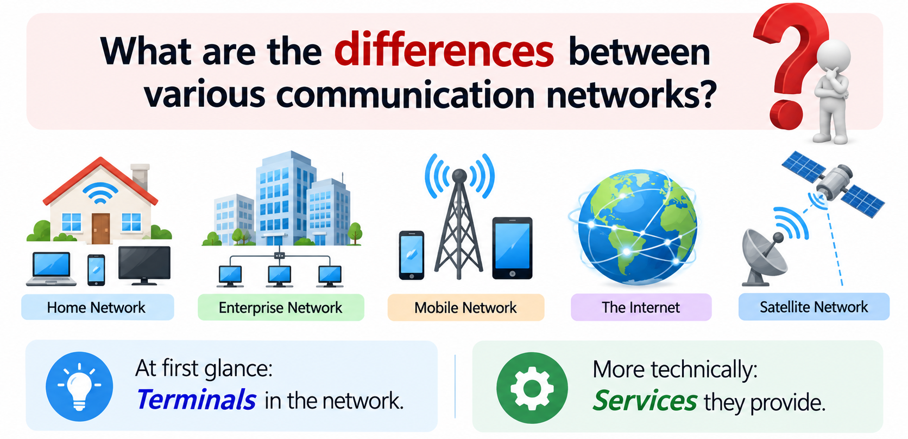
Question: What are the differences between various communication networks?
Question
At first glance: Terminals in the network.
More technically: Services they provide.

Slide 9
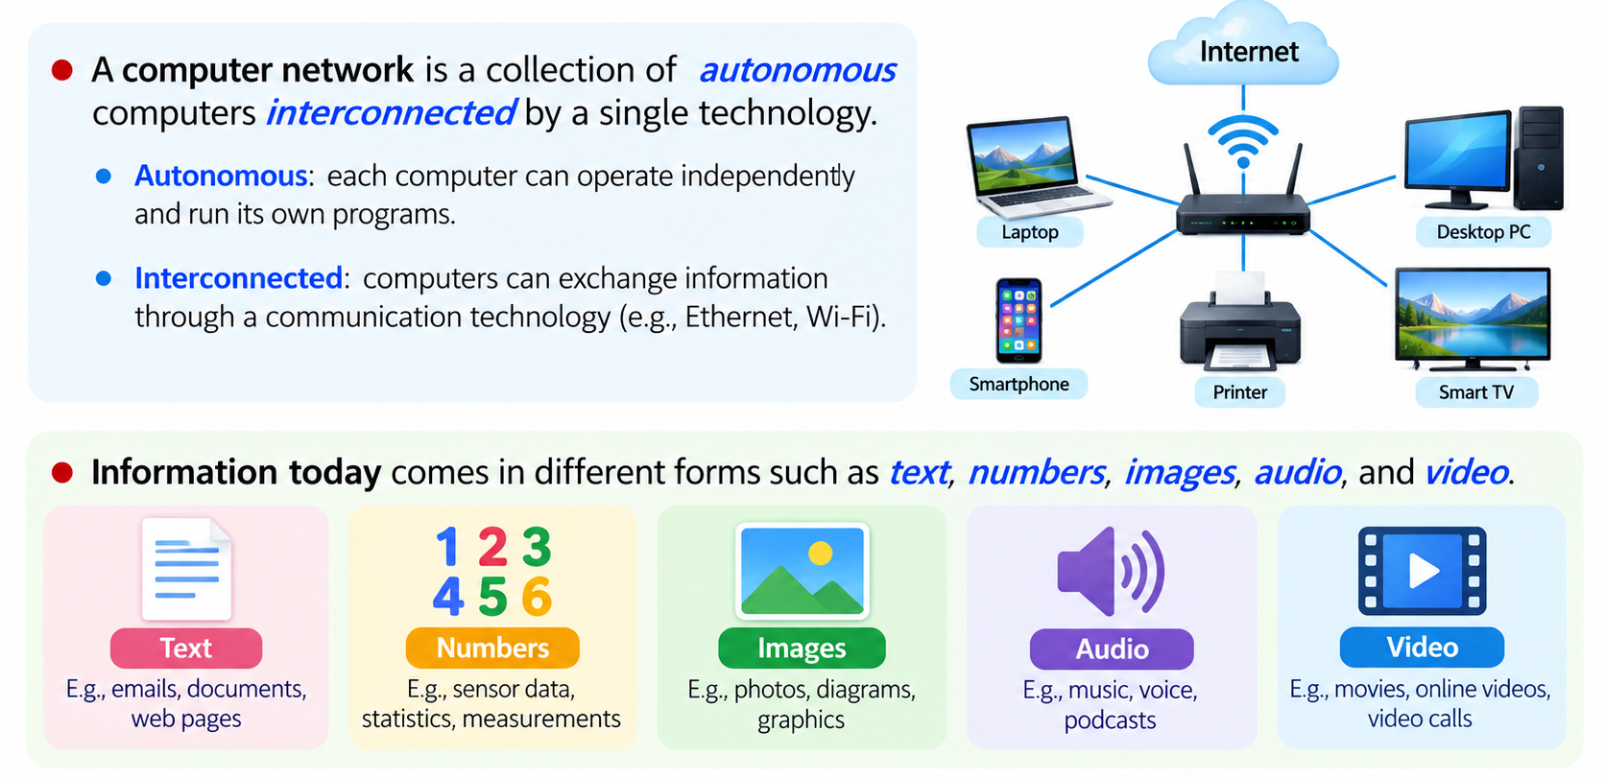
What is a Computer Network?
Computer Network: a collection of autonomous computers interconnected by a single technology
  autonomous: be able to compute independently
  interconnected: be able to exchange information
Information today comes in different forms such as text, numbers, images, audio, and video.

Slide 10
Uses of Computer Networks
Computer networks are collections of autonomous computers, e.g., the Internet
They have many uses:
  Business Applications »
  Home Applications »
  Mobile Applications »
These uses raise:
  Social Issues »
This text covers networks for all of these uses

Slide 11
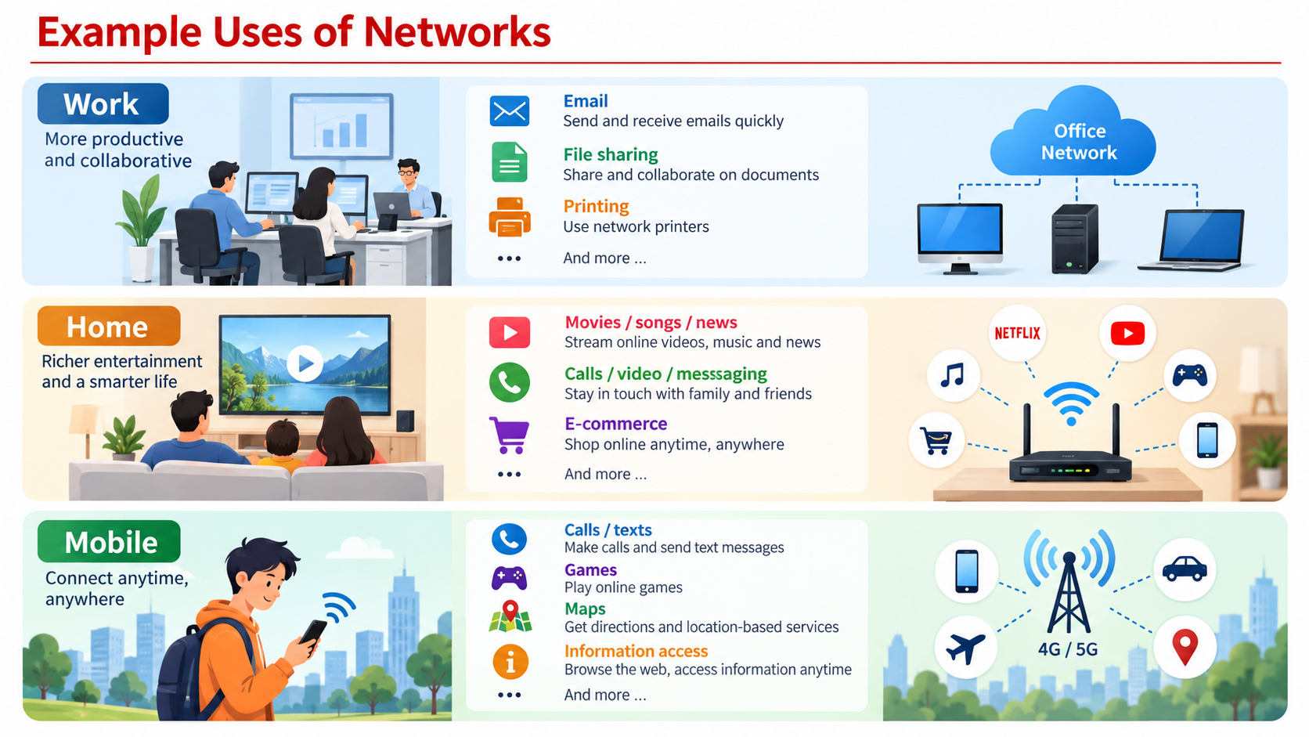
Example Uses of Networks
Computer Networks, Chapter 1 Introduction

Slide 12
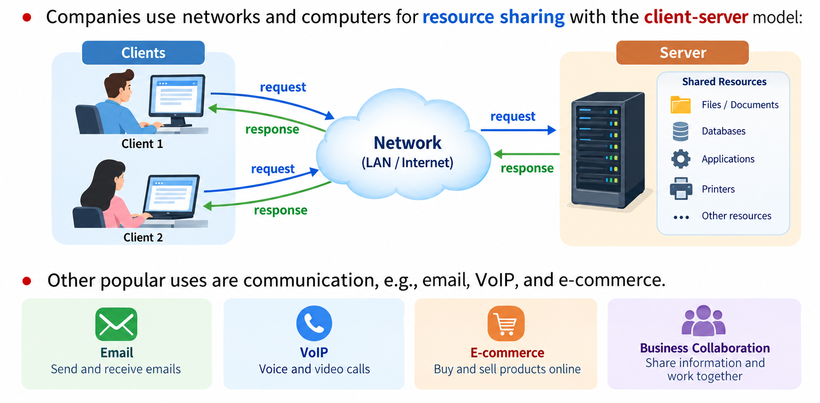
Business Applications

Slide 13
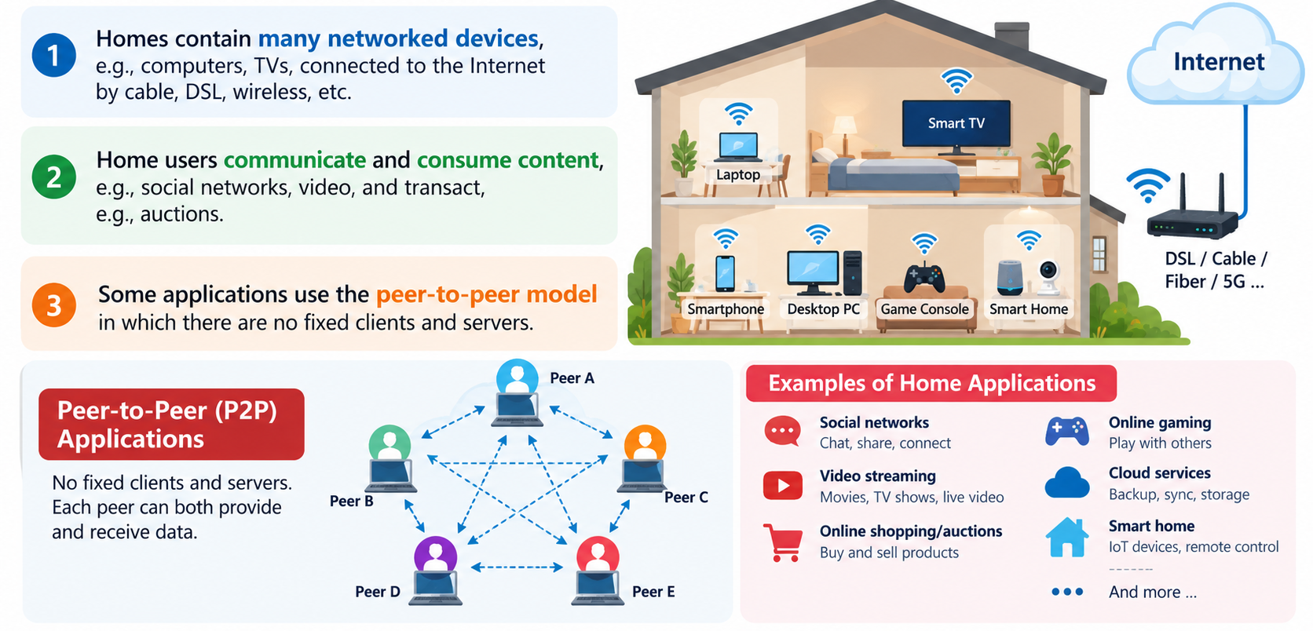
Home Applications

Slide 14
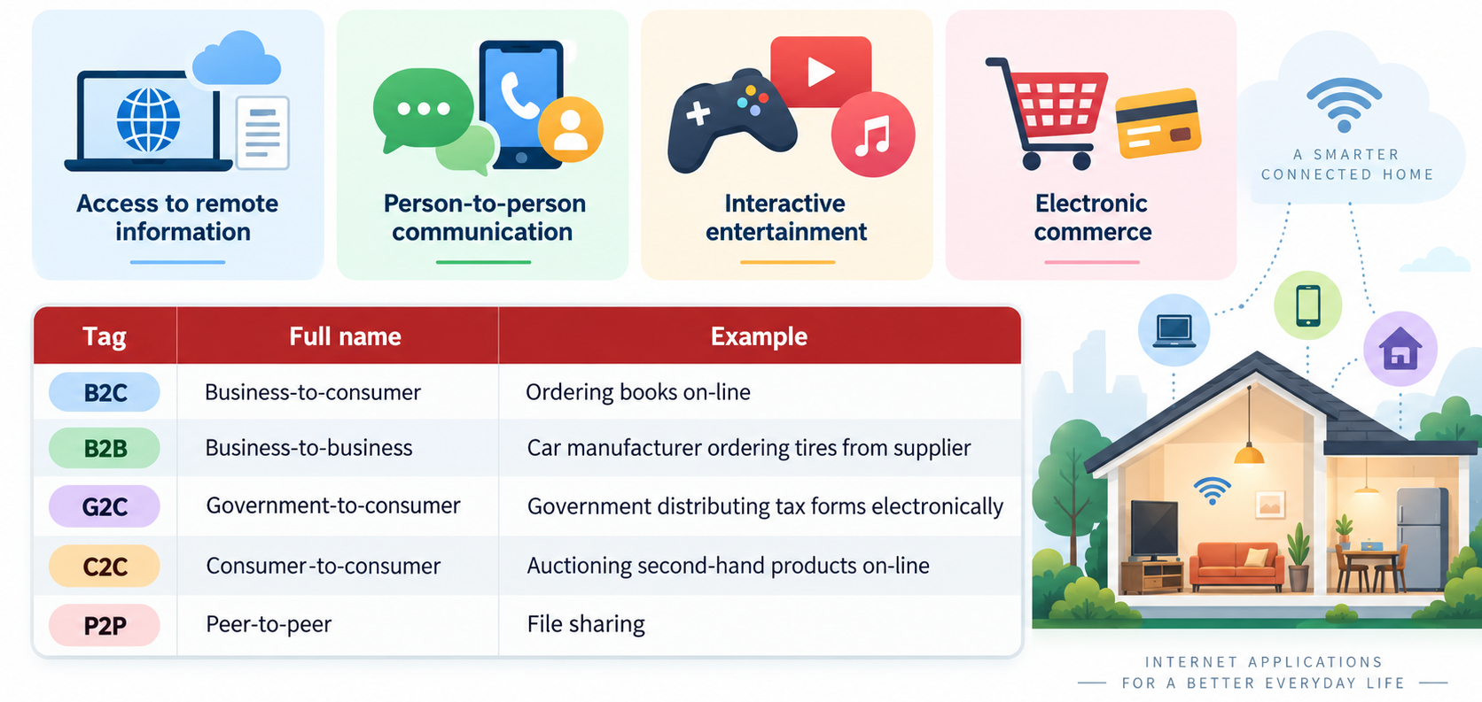
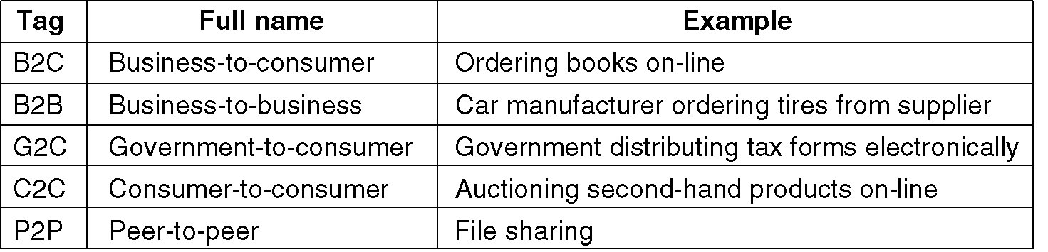
Home Applications
Access to remote information
Person-to-person communication
Interactive entertainment
Electronic commerce

Slide 15
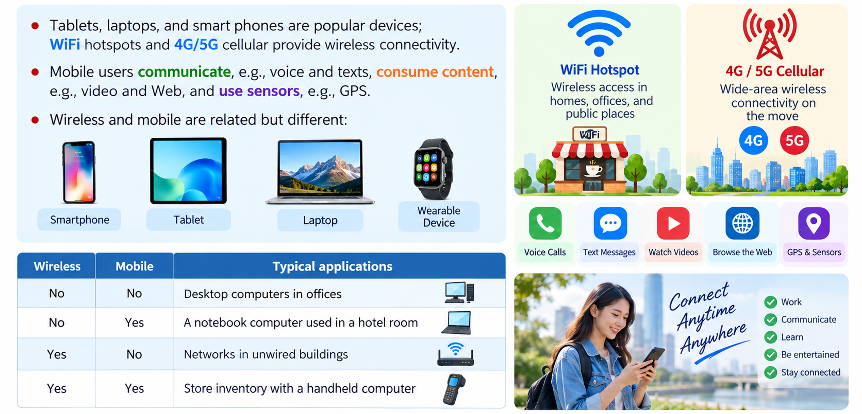
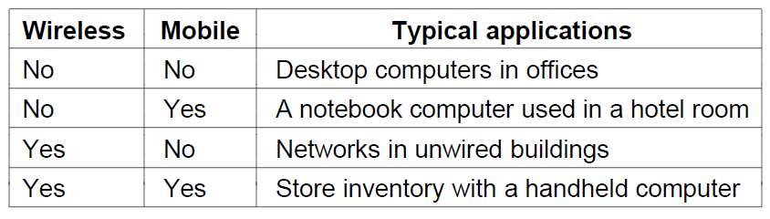
Mobile Users
Tablets, laptops, and smart phones are popular devices; WiFi hotspots and 4G/5G cellular provide wireless connectivity.
Mobile users communicate, e.g., voice and texts, consume content, e.g., video and Web, and use sensors, e.g., GPS.
Wireless and mobile are related but different:

Slide 16
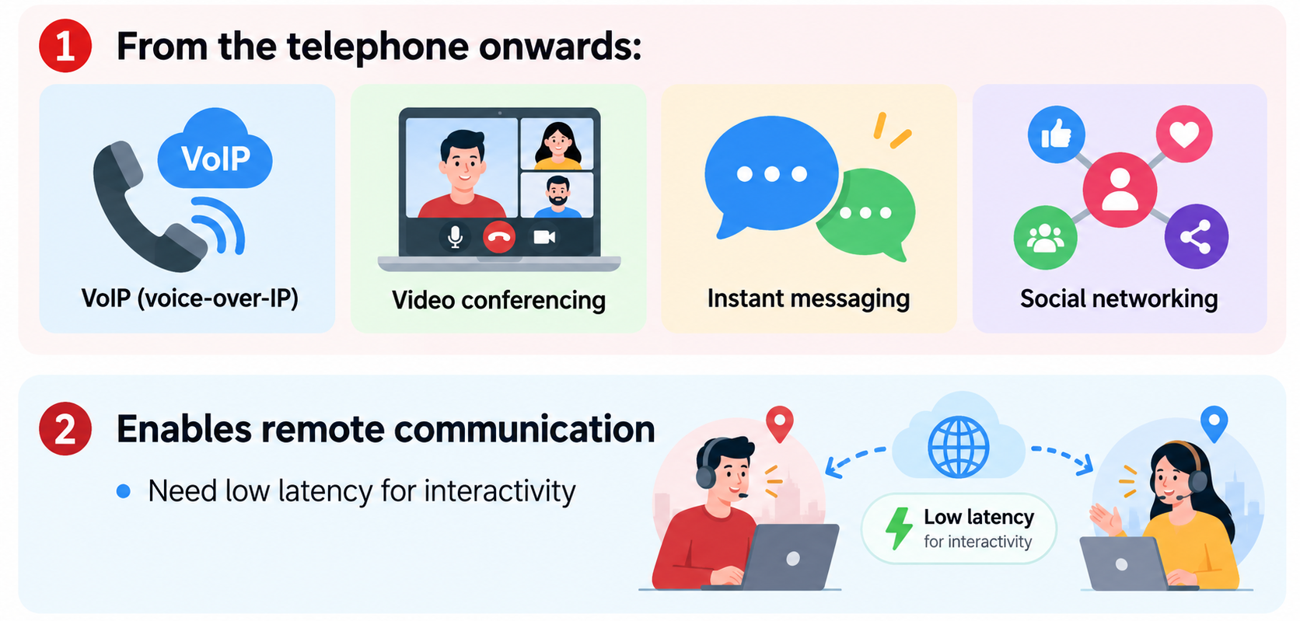
For User Communication
From the telephone onwards:
  VoIP (voice-over-IP)
  Video conferencing
  Instant messaging
  Social networking
Enables remote communication
  Need low latency for interactivity

Slide 17
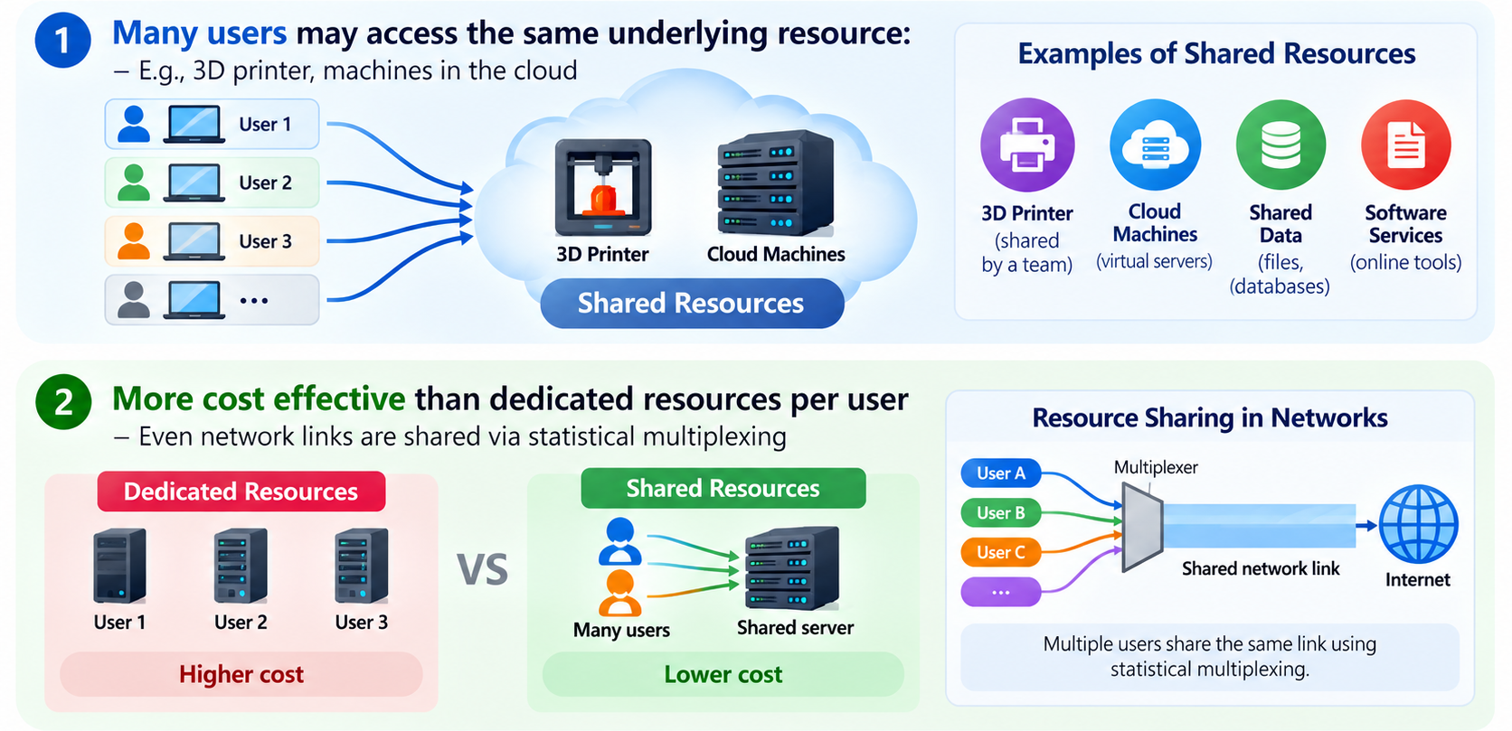
For Resource Sharing
Many users may access the same underlying resource:
  E.g., 3D printer, machines in the cloud
More cost effective than dedicated resources per user
  Even network links are shared via statistical multiplexing

Slide 18
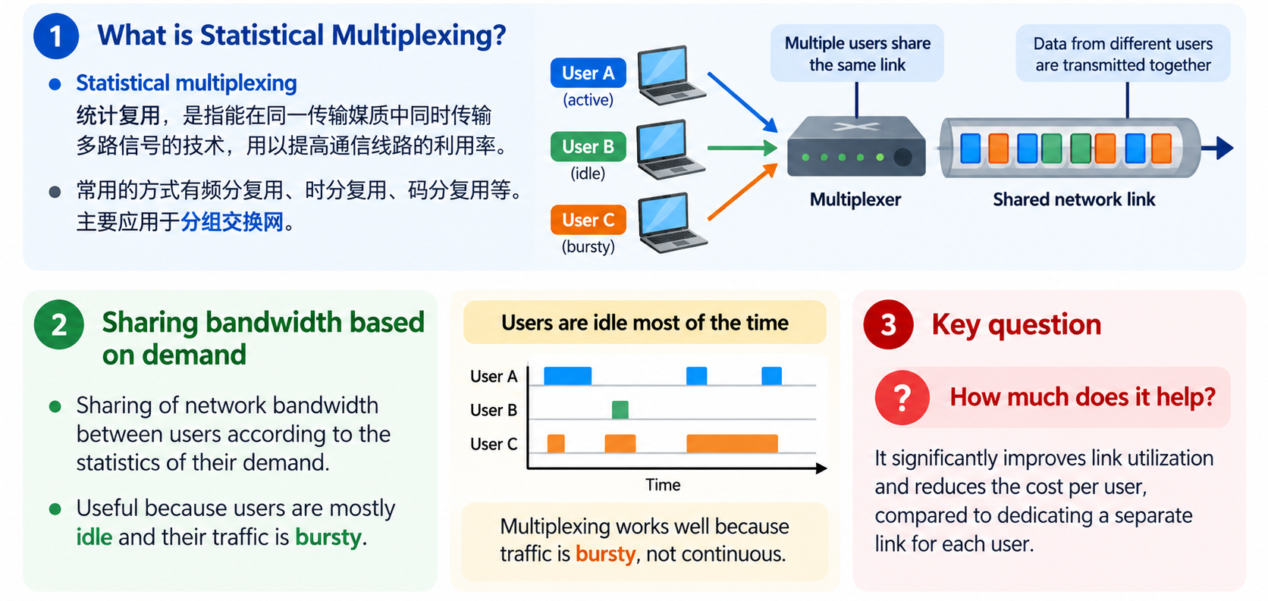
Statistical Multiplexing
Statistical Multiplexing
  统计复用，是指能在同一传输媒质中同时传输多路信号的技术，用以提高通信线路的利用率。常用的方式有频分复用、时分复用、码分复用等。主要应用于分组交换网。
Sharing of network bandwidth between users according to the statistics of their demand:
  Multiplexing just means sharing
  Useful because users are mostly idle and their traffic is bursty.
Key questions:
  How much does it help?

Slide 19
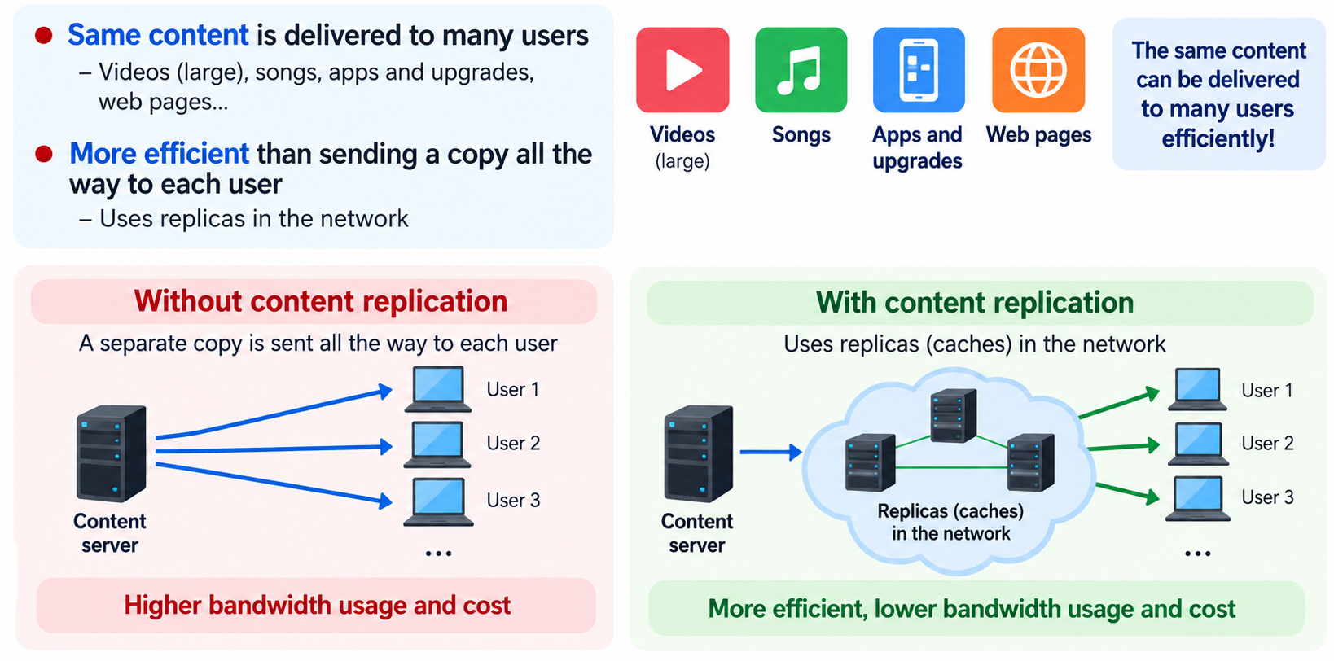
For Content Delivery
Same content is delivered to many users
  Videos (large), songs, apps and upgrades, web pages…
More efficient than sending a copy all the way to each user:
  Uses replicas in the network

Slide 20
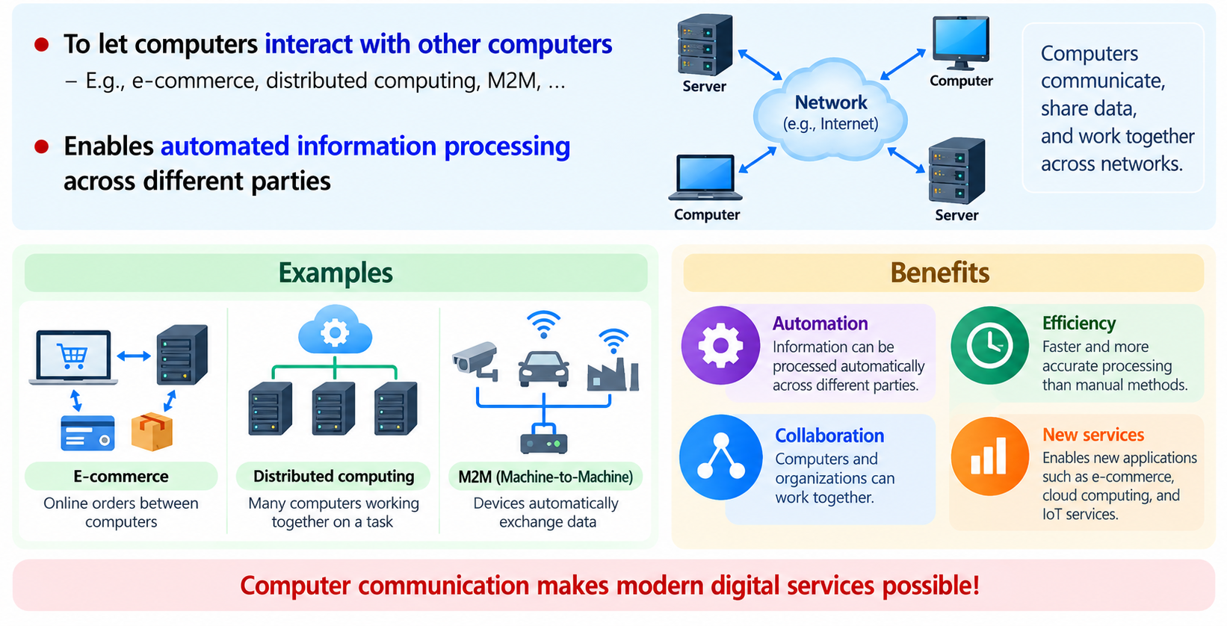
For Computer Communication
To let computers interact with other computers
  E.g., e-commerce, distributed computing, M2M, …
Enables automated information processing across different parties

Slide 21
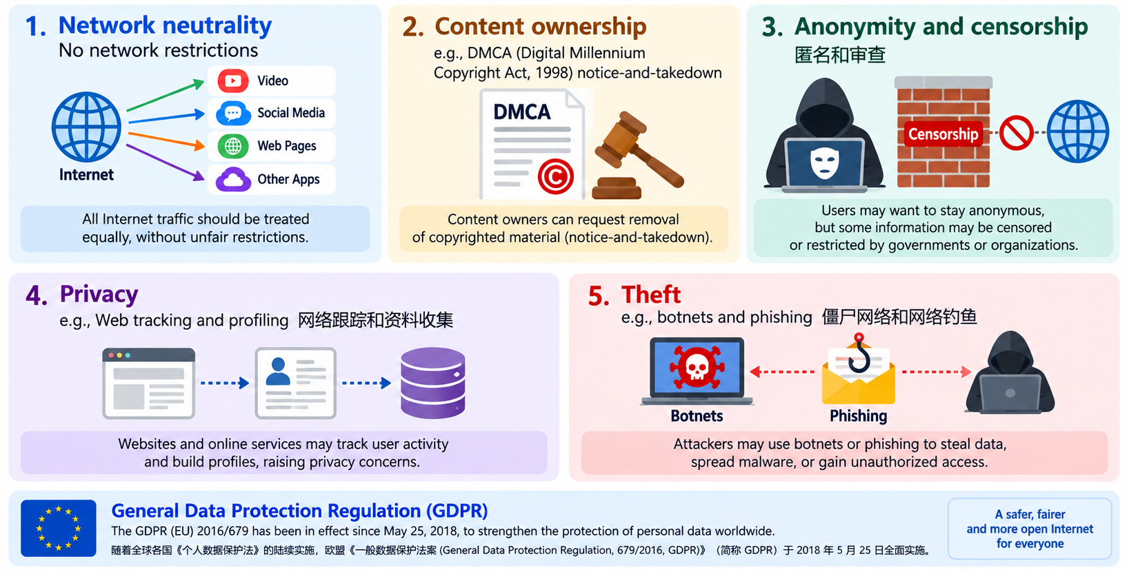
Social Issues
  Network neutrality – no network restrictions
  Content ownership, e.g., DMCA (Digital Millennium Copyright Act数字千年版权法案, 1998) notice-and-takedown
  Anonymity and censorship 匿名和审查
  Privacy, e.g., Web tracking and profiling网络跟踪和资料收集
  Theft, e.g., botnets and phishing 僵尸网络和网络钓鱼
随着全球各国《个人数据保护法》的陆续实施，欧盟《一般数据保护法案(General Data Protection Regulation, 679/2016, GDPR )》（简称GDPR）于 2018 年 5 月 25 日全面实施。

Slide 22
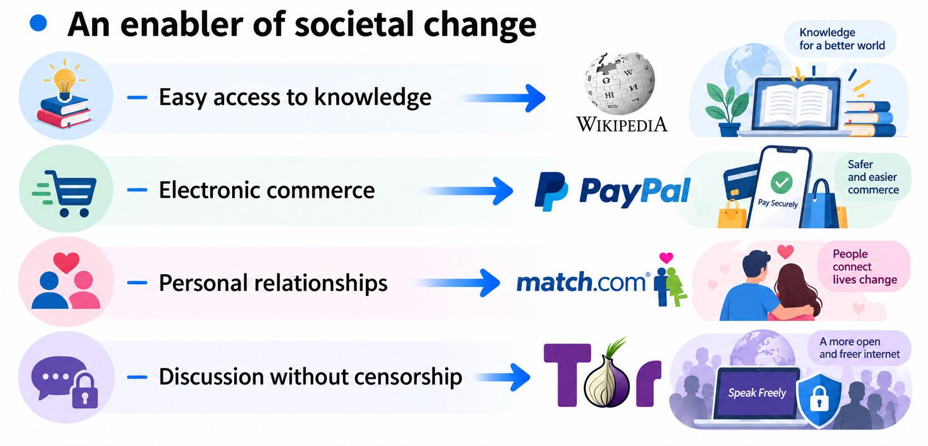
Internet – Societal Impact

Slide 23
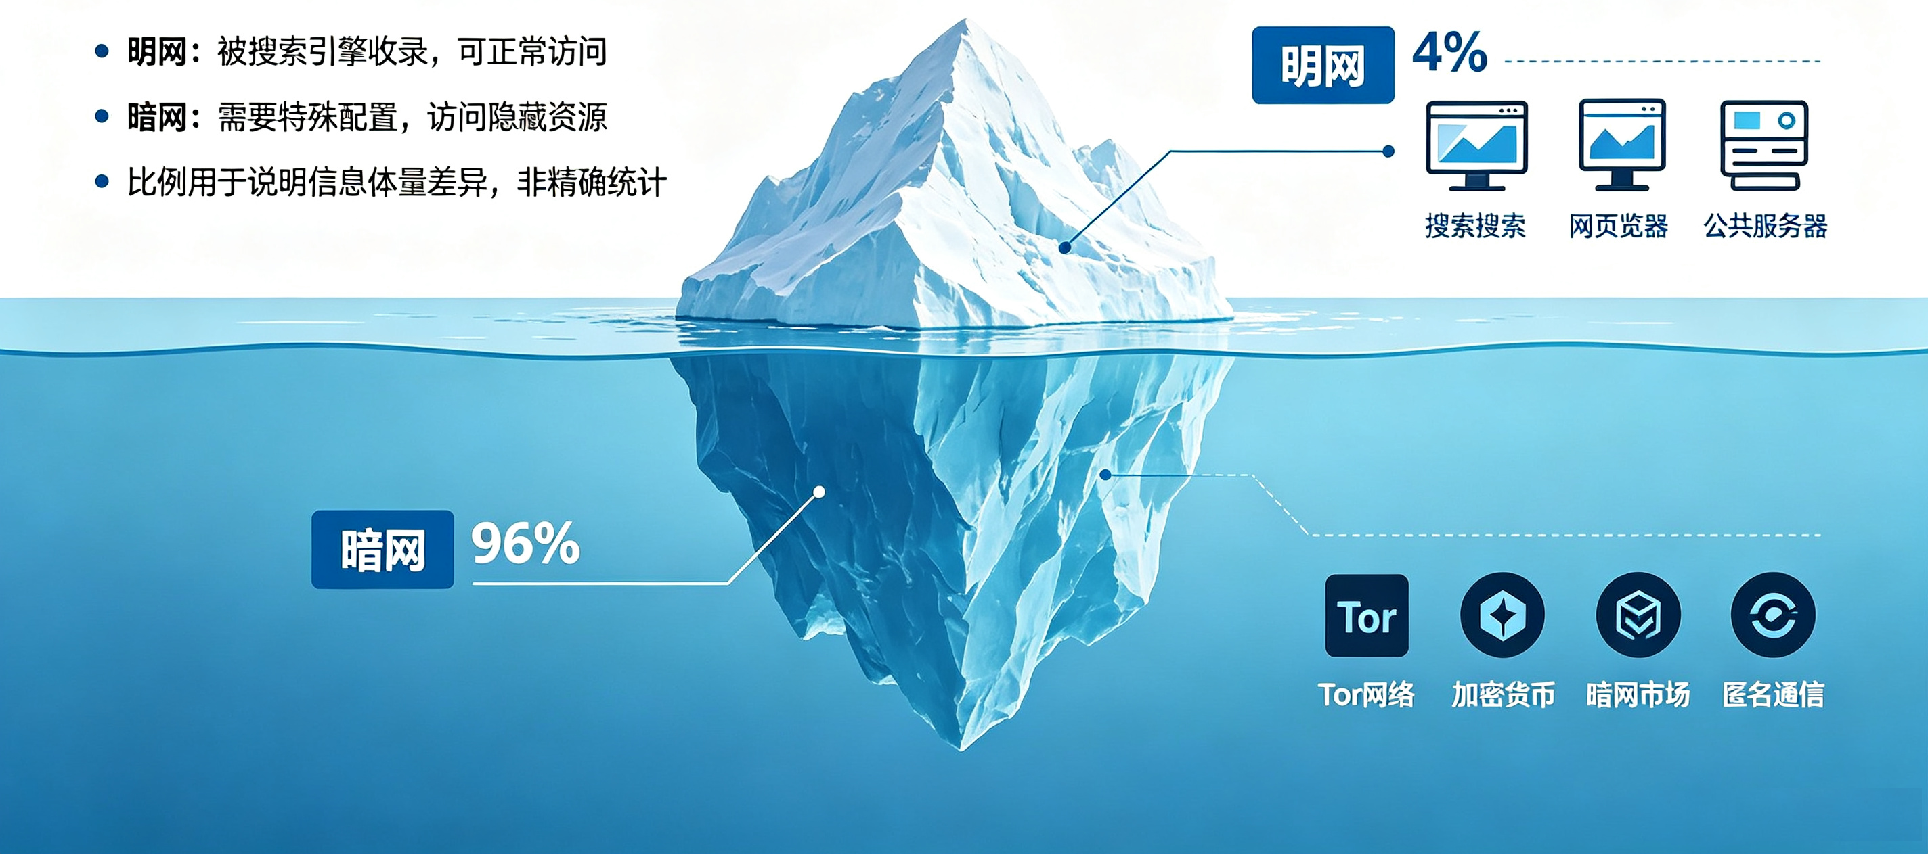
Internet – Societal Impact

Slide 24
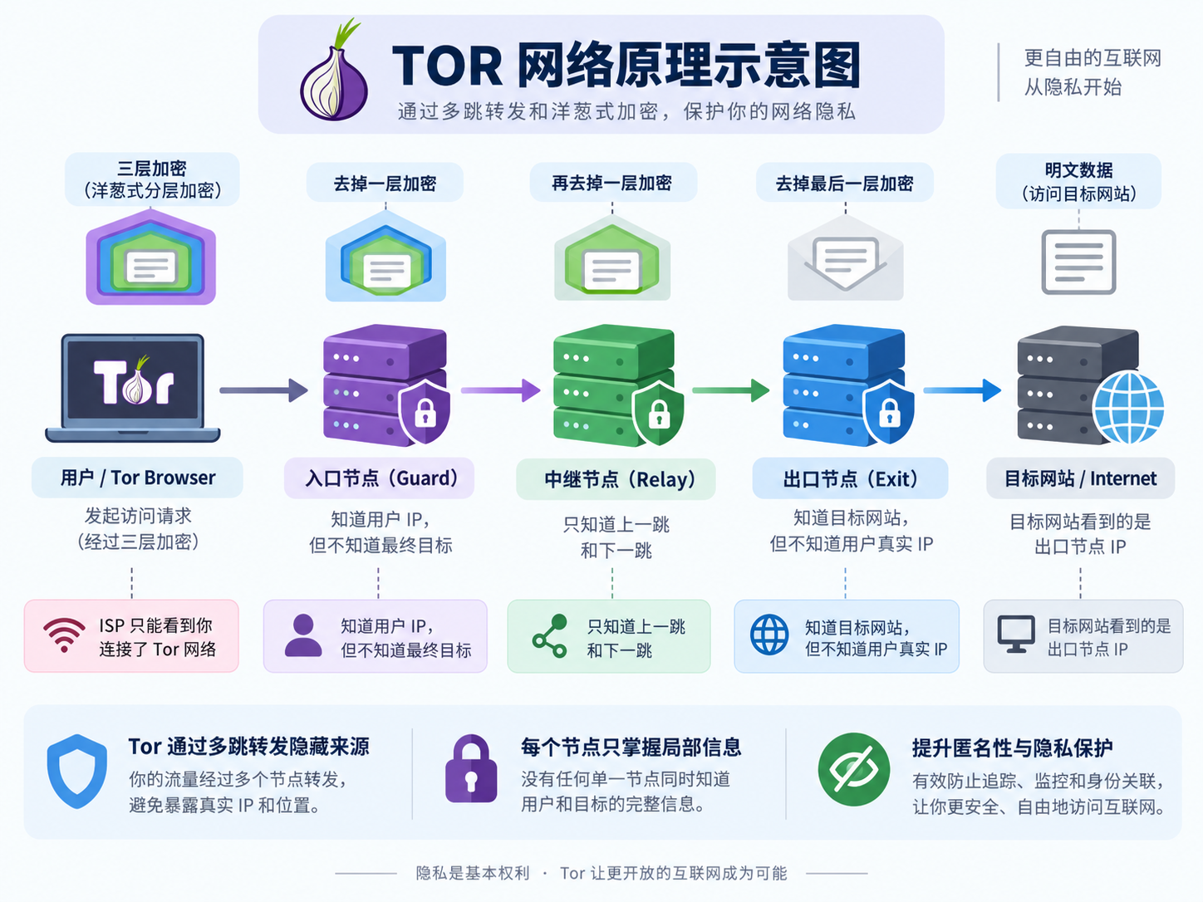
Internet – Societal Impact：TOR (The Onion Routing)

Slide 25
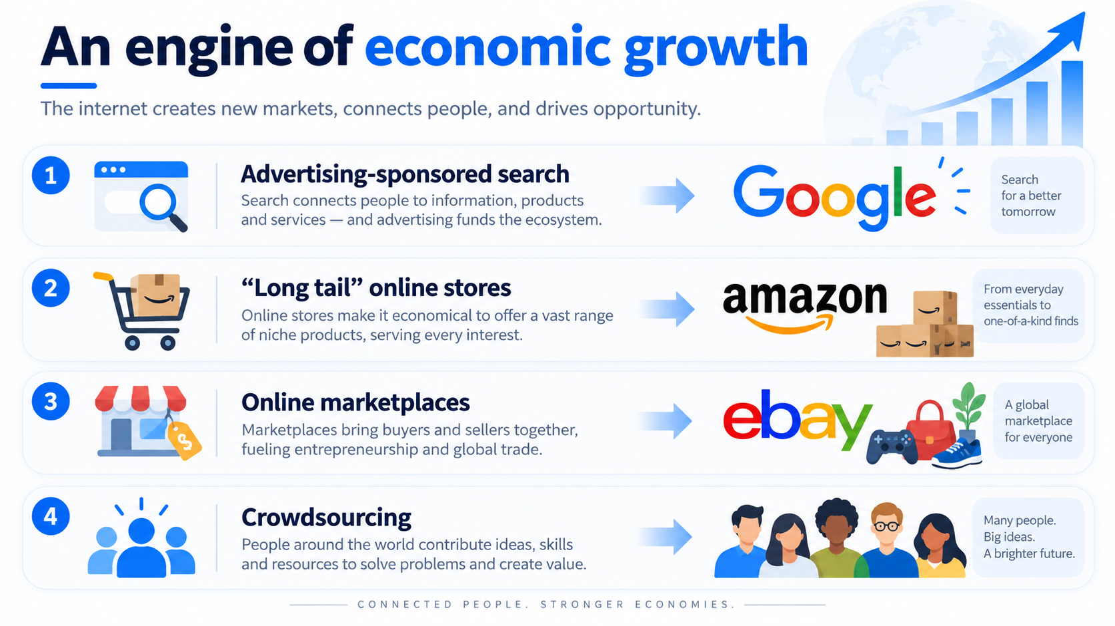
Internet – Economic Impact

Slide 26
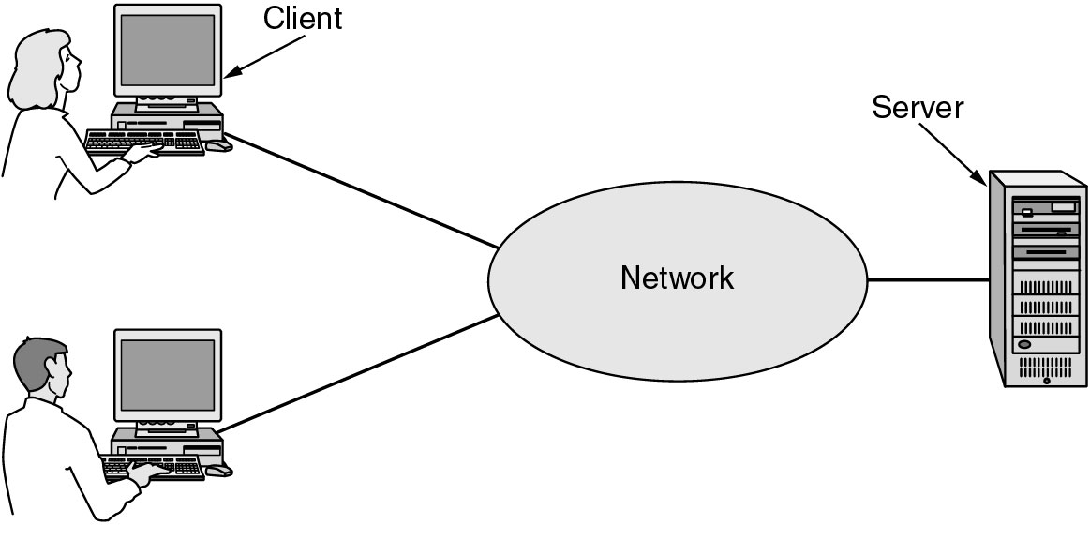
Focus of the course
Three “Networking” topics:
? ? ?
Distributed Systems
Networking
Communications
We’re in the middle

Slide 27
The main point
To learn how the Internet works
  What really happens when you “browse the web”?
  What are TCP/IP, DNS, HTTP, NAT, VPNs, 802.11 etc…
To learn the fundamental of computer networks:
  What hard problems must they solve?
  What design strategies have proven valuable?
Issue | Example mechanisms at different layers
Reliability despite failures | Codes for error detection/correction (§3.2, 3.3) Routing around failures (§5.2)
Network growth and evolution | Addressing (§5.6) and naming (§7.1) Protocol layering (§1.3)
Allocation of resources like bandwidth | Multiple access (§4.2) Congestion control (§5.3, 6.3)
Security against various threats | Confidentiality of messages (§8.2, 8.6) Authentication of communicating parties (§8.7)

Slide 28
What really happens when you “browse the web”?
② DNS 解析
域名 → IP 地址
① 浏览器
输入 URL / 点击链接
③ 本机协议栈
Socket → TLS → TCP/QUIC
④ 家庭/校园路由器
NAT + 默认网关
⑤ 运营商/Internet
路由转发：逐跳查表
⑥ Web / CDN 服务器
处理请求并返回资源
响应回程：HTML / CSS / JS / 图片
经相反方向逐跳返回，浏览器解析并渲染页面
报文封装 / 解封装：每层只关心自己的“头部”
TCP/IP 协议栈中的关键职责
Eth / Wi‑Fi
IP
TCP / UDP
TLS
HTTP
Data
应用层：DNS / HTTP / HTTPS
NAT 重点：内网 192.168.x.x:port
⇄ 公网 IP:port；
靠端口映射找回会话
传输层：TCP 可靠传输；UDP/QUIC 低时延
到达服务器后逐层解封装
应用层看到 HTTP 请求
网络层：IP 地址、路由、TTL、分片
HTTPS 重点：HTTP 内容被 TLS 加密；
中间路由器通常只看 IP/端口，不看网页正文
链路层：MAC、以太网/Wi‑Fi 帧、ARP/ND
1 URL
浏览器解析 scheme/host/path
2 DNS
查缓存；递归/迭代查询
3 连接
TCP 三次握手 或 QUIC；TLS 握手
4 HTTP
发送 GET/POST，请求头/Body
5 转发
IP 路由 + NAT 地址/端口转换
6 渲染
收到响应，解析 DOM/CSSOM，加载子资源

Slide 29
Chapter1：Introduction
  Uses of Computer Networks
  Network Hardware
  Network Software
  Reference Models
  Example Networks
  Network Standardization
  Metric Units

Slide 30
Network Hardware
Types of connection
Network Topologies
Types of network

Slide 31
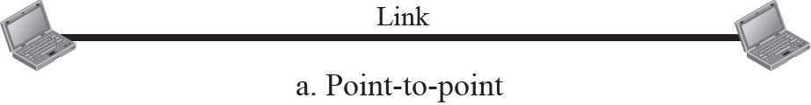
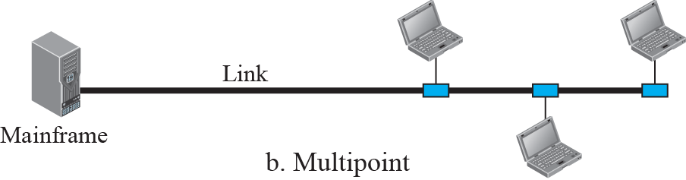
Types of connection

Slide 32
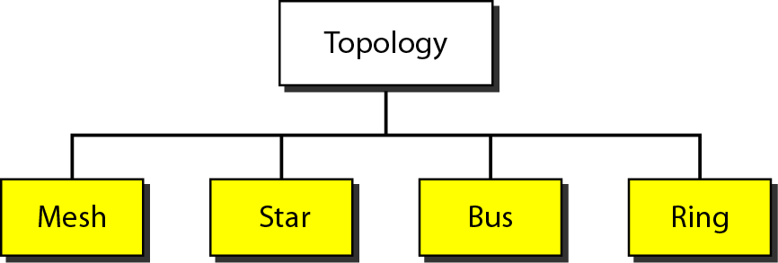
Network Topologies

Slide 33
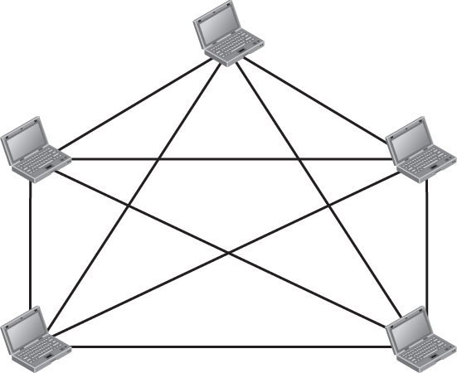


A fully-connected mesh topology
优点：
最短路径多，路由效率高；
缺点：
连线复杂，容易出错；
链路故障定位困难；
网卡端口数受限，影响组网规模；
大量环路，易产生广播风暴，破坏代价高；

Slide 34
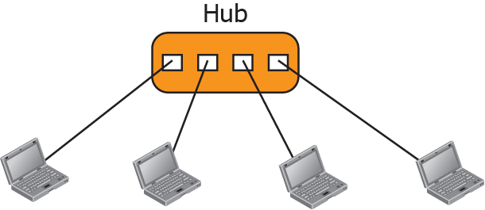
A star topology
优点：
组网简单；
数据交互简单。
缺点：
Hub端口数受限，组网规模小。

Slide 35
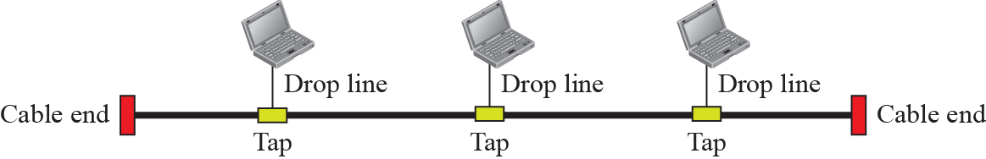
A bus topology
优点：
网络结构简单，易于网络扩展；
设备少、造价低，安装和使用方便；
具有较高的可靠性。因为单个节点的故障不会涉及整个网络。
缺点：
总线传输距离有限，通信范围受到限制；
故障诊断和隔离比较困难。当节点发生故障，隔离起来还比较方便，一旦传输介质出现故障时，就需要将整个总线切断；
易于发生数据碰撞，线路争用现象比较严重

Slide 36
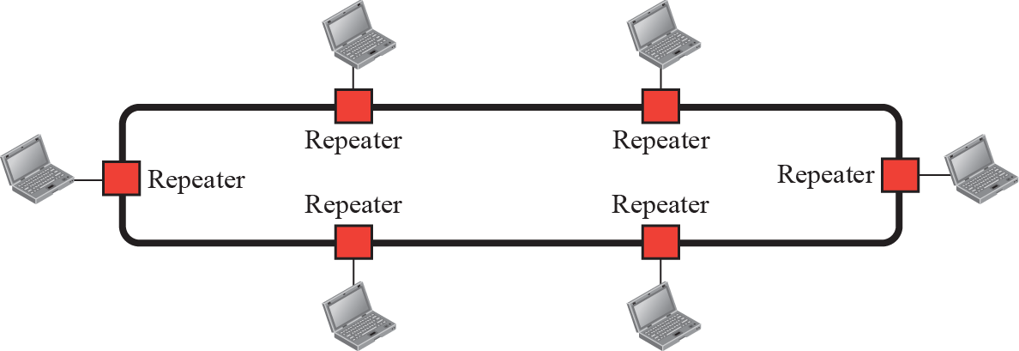
A ring topology
优点：
电缆长度短，只需要将各节点逐次相连；
可使用光纤。光纤的传输速率很高，十分适合于环形拓扑的单方面传输；
所有站点都能公平访问网络的其他部分，网络性能稳定。
缺点：
Repeater节点故障会引起全网故障，是因为数据传输需要通过环上的每一个节点，如某一节点故障，则引起全网故障；
节点的加入和撤出过程复杂；

Slide 37
传统数据中心网络拓扑结构
核心
核心
Layer3
核心
Layer2
Layer3
POD1
POD2
POD1
POD2
POD1
POD2
汇聚
汇聚
汇聚
Layer2
STP
iStack
接入
接入
接入
3层架构
方案：Ethernet，STP/MSTP
问题：避免环路，阻塞一半端口，50%端口/链路利用率
3层架构+交换机虚拟集群
方案：交换机采用虚拟集群技术（M-LAG、vPC、CSS/iStack）,所有端口可用，提升组网效率。
问题：L2网络规模小，扩展性差，不满足云化DC大二层（跨POD）需求；无法异厂家堆叠，且可能无法无损升级。
扩展的L2架构
方案：L3功能上移Core交换机。
问题：云化DC东西流量巨大，Core交换机成为瓶颈。

Slide 38
云数据中心网络诉求和关键技术
“大”：支持数万甚至更多的服务器，百万级的VM接入，远超4K的租户网络；
“低成本水平扩展”：不依赖于高端交换机的纵向扩展，而是采用普通盒式交换机的水平扩展；
“位置无关”：逻辑网络和物理网络解耦，支持虚拟机迁移，网络策略跟着VM走（VM aware Network）；
“胖”：云DC内东西流量大（收敛比2:1~7:1），而且能适应收敛比的变化（东西和南北流量可以独立扩容）；
“自动化”：为不同租户动态、按需创建相互隔离的虚拟网络。
1
基于Leaf-Spine的full-mesh可扩展架构；
2
overlay技术实现网络虚拟化，逻辑网络和物理网络解耦
3
基于SDN技术的统一资源调度（集成到CloudOS）

Slide 39
Leaf-Spine网络架构
Overlay Tunnel
SDN Controller
Key technologies
IPBB
NFV-based
(VNF, MANO, VIM)
Spine
Spine
Spine
Spine
DC GW
ECMP
IP Routing:
OSPF/BGP
IP Fabric
Container-based
(PaaS)
Layer 3
Leaf
Leaf
Leaf
Leaf
Border
Leaf
Border
Leaf
MANO
Virtualization
(VM, DPDK, SRIOV, vSwtich, IPVLAN )
Layer 2
Mgnt Node
Compute Node
Edge Node
Openstack
Server
FW/NAT
NFVO
MANO
Server
Gateway
IP Fabric
(Static, OSPF, BGP routing)
OSS
Server
Server
VNFM
Overlay network
(NVO3: VxLAN, GRE)
VNF1
VNF2
VIM
VM
VM
Bare Metal
Container
Container
Container
Container
Container
Network Automation
(Openstack integrated SDN)
PaaS
高扩展、虚拟化和自动化推动云数据中心网络发展

Slide 40



分层网络模型
外部网络
VRF
eBGP/Static
eBGP
CE
SDN GW
Server
业务层网络
VRF
VRF
VNF
(router)
主FW
CE
BD
BD
控制面：eBGP
数据面：L3VPN
备FW
VRF
业务接入
VNF
(host)
DCGW
BD
双活网关
SDN GW
L3VPN Service
L2/L3 VXLAN
VTEP
L2/L3 VXLAN
IP ECMP
CE
SDN GW
L2/L3 VNI
BGP VXLAN EVPN
Server
Overlay层网络
Spine
VM
L2/L3 VXLAN
CE
VM
控制面：iBGP EVPN
数据面：VXLAN
业务接入
VM
SDN GW
VM
VTEP
VXLAN
VLAN/QinQ
VTEP
VRF
BD
VRF
BD
CE
SDN GW
Spine
物理层网络
VM
CE
OSPF
VM
控制面：OSPF
数据面：IP
SR-IOV
vSwitch
SR-IOV
vSwitch
VM
VM
VM
VM
VM
VM
VM
VM
VM
SDN GW
业务接入
VM
Servers
Servers
IP Fabric

Slide 41
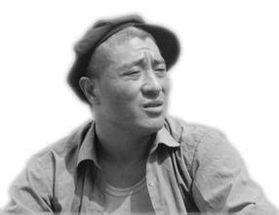
小结：高扩展、虚拟化和自动化推动云数据中心网络的发展
高扩展、低成本的物理网络
IP Fabric架构
“世界上没有什么网络问题是加一层(Overlay)不能解决的，如果有，就加两层！”
--- 尼古拉斯.赵四
虚拟化、大二层逻辑网络
基于Overlay逻辑和物理解耦
SDN和Overlay本无关，为了DC网络自动化走到了一起
VM/容器感知和网络自动化
SDN
（集成到Cloud OS）

Slide 42
Types of Network
关于计算机网络，没有一种被普遍接受的分类方法，但有两个因素是非常重要的：传输技术和距离尺度。

Slide 43
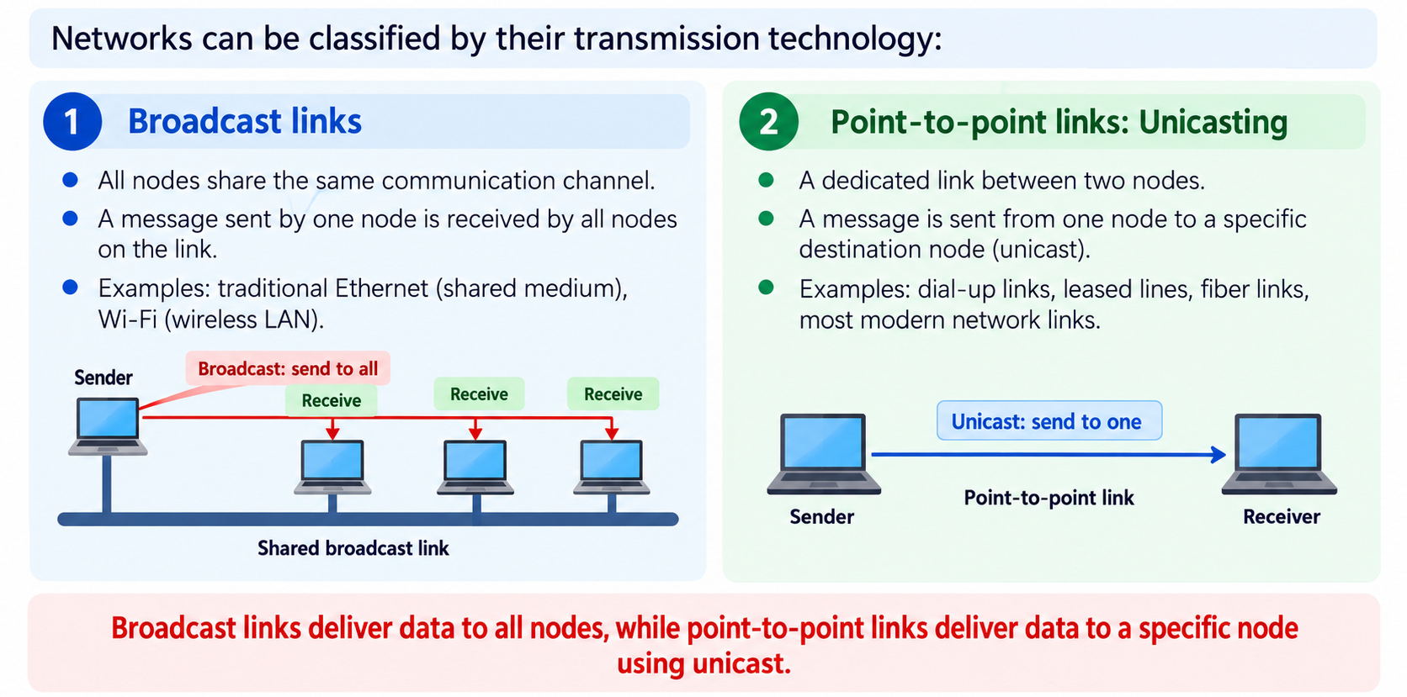
Types of Network – by transmission technology
Networks can be classified by their transmission technology:
Broadcast links
Point-to-point links：Unicasting

Slide 44
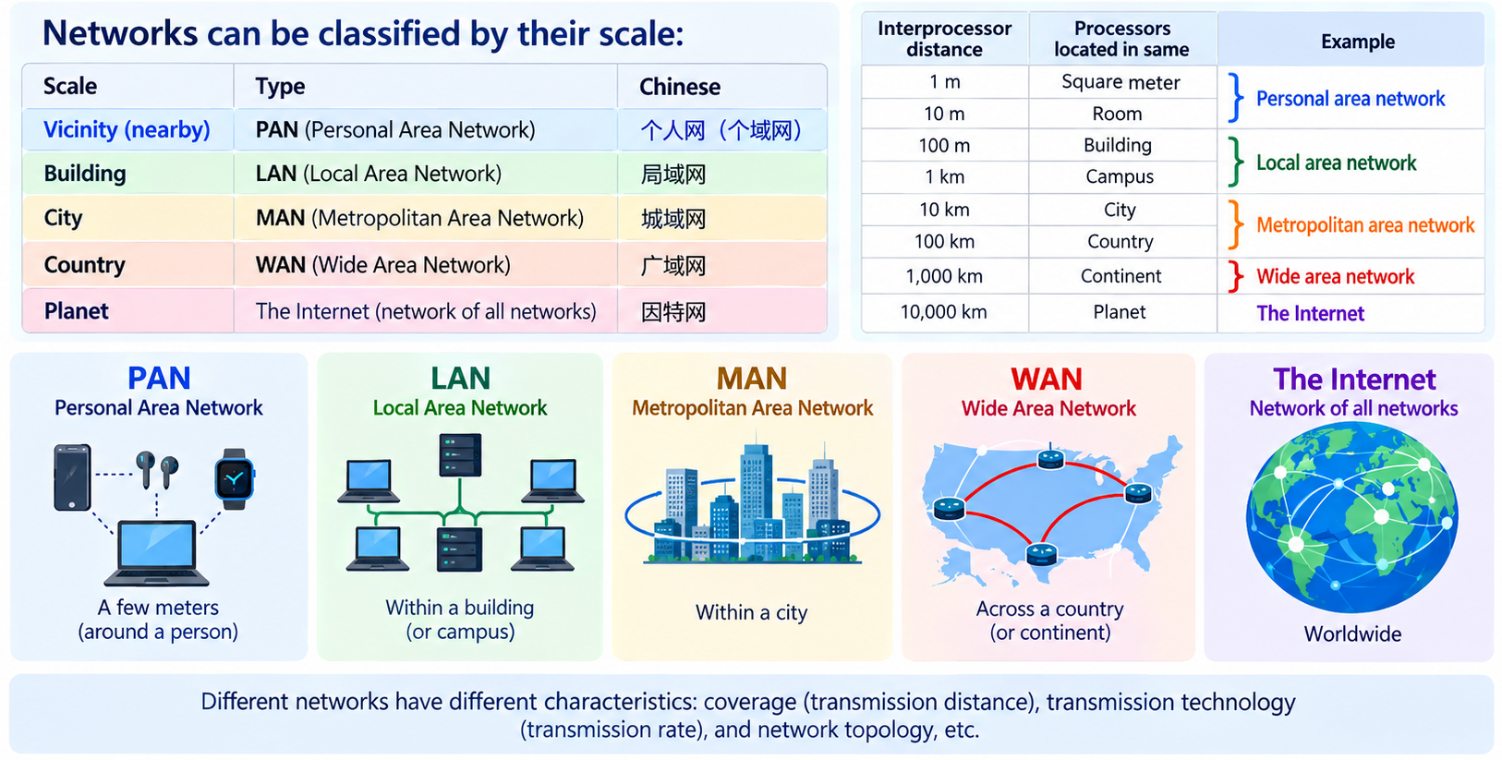
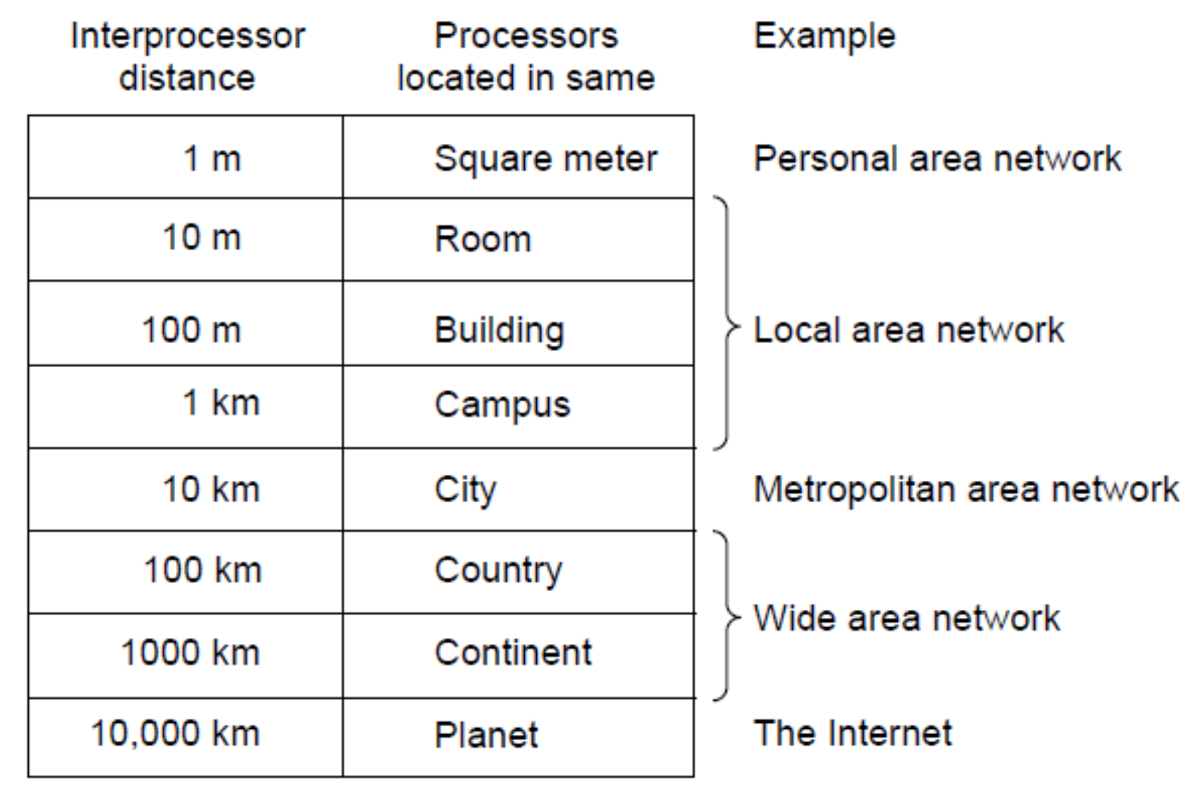
Types of Network – by scale
Networks can be classified by their scale:
Scale | Type
Vicinity近邻 | PAN (Personal Area Network) » 个人网（个域网）
Building大楼 | LAN (Local Area Network) » 局域网
City城市 | MAN (Metropolitan Area Network) » 城域网
Country国家 | WAN (Wide Area Network) » 广域网
Planet地球 | The Internet (network of all networks) » 因特网
不同网络有各自的特征：范围（决定了传输时间）、传输技术（决定传输速率）、拓扑结构等。

Slide 45
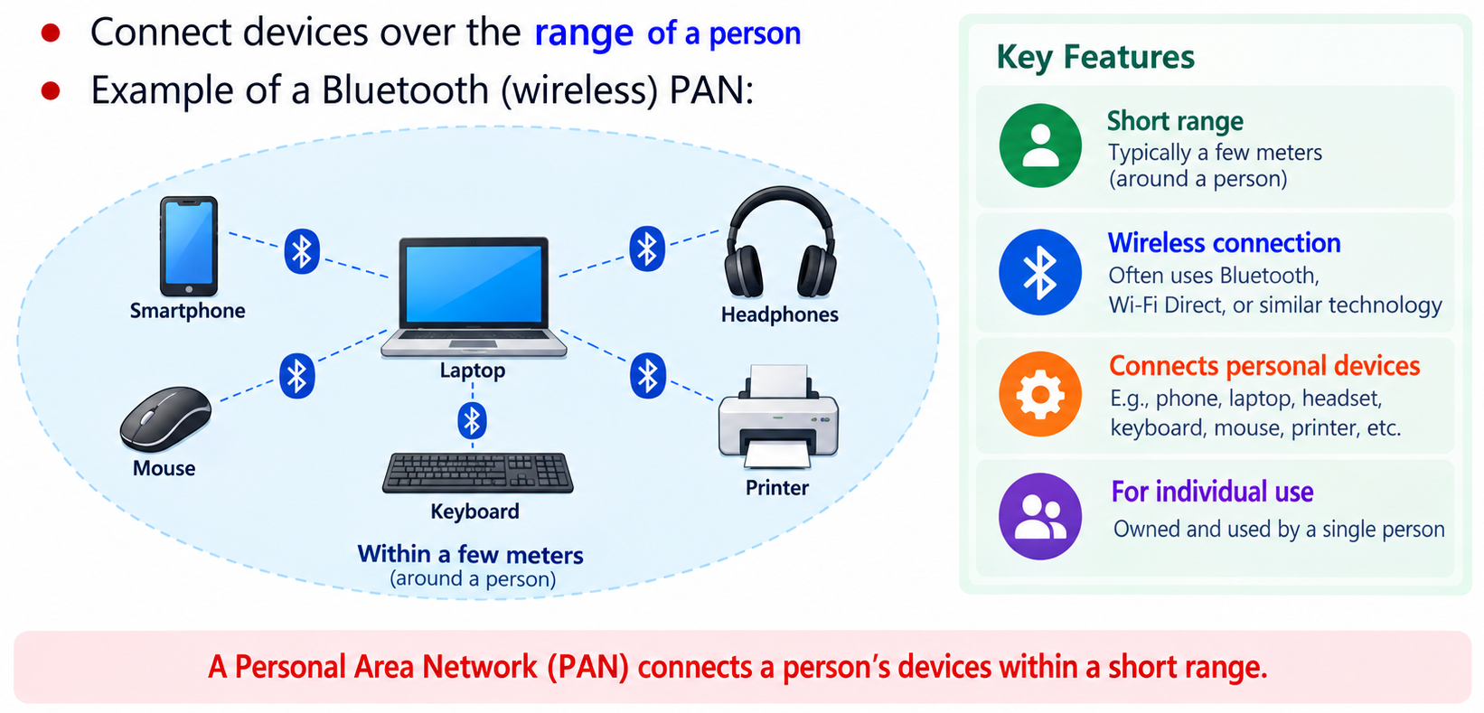
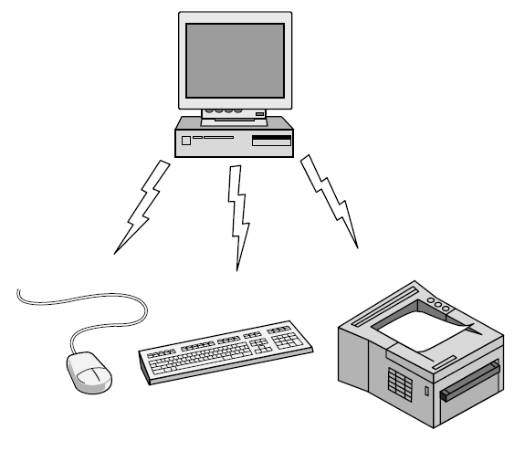
Personal Area Network
Connect devices over the range of a person
Example of a Bluetooth (wireless) PAN:

Slide 46
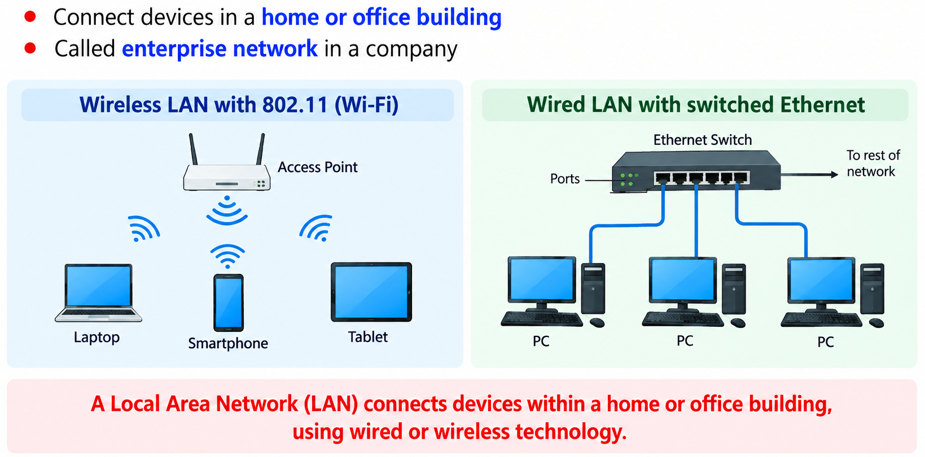
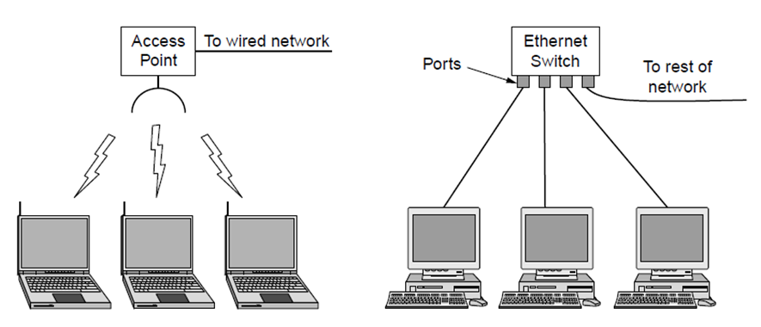
Local Area Networks
Connect devices in a home or office building
Called enterprise network in a company
To wired network
Wireless LAN
with 802.11
Wired LAN with
switched Ethernet

Slide 47
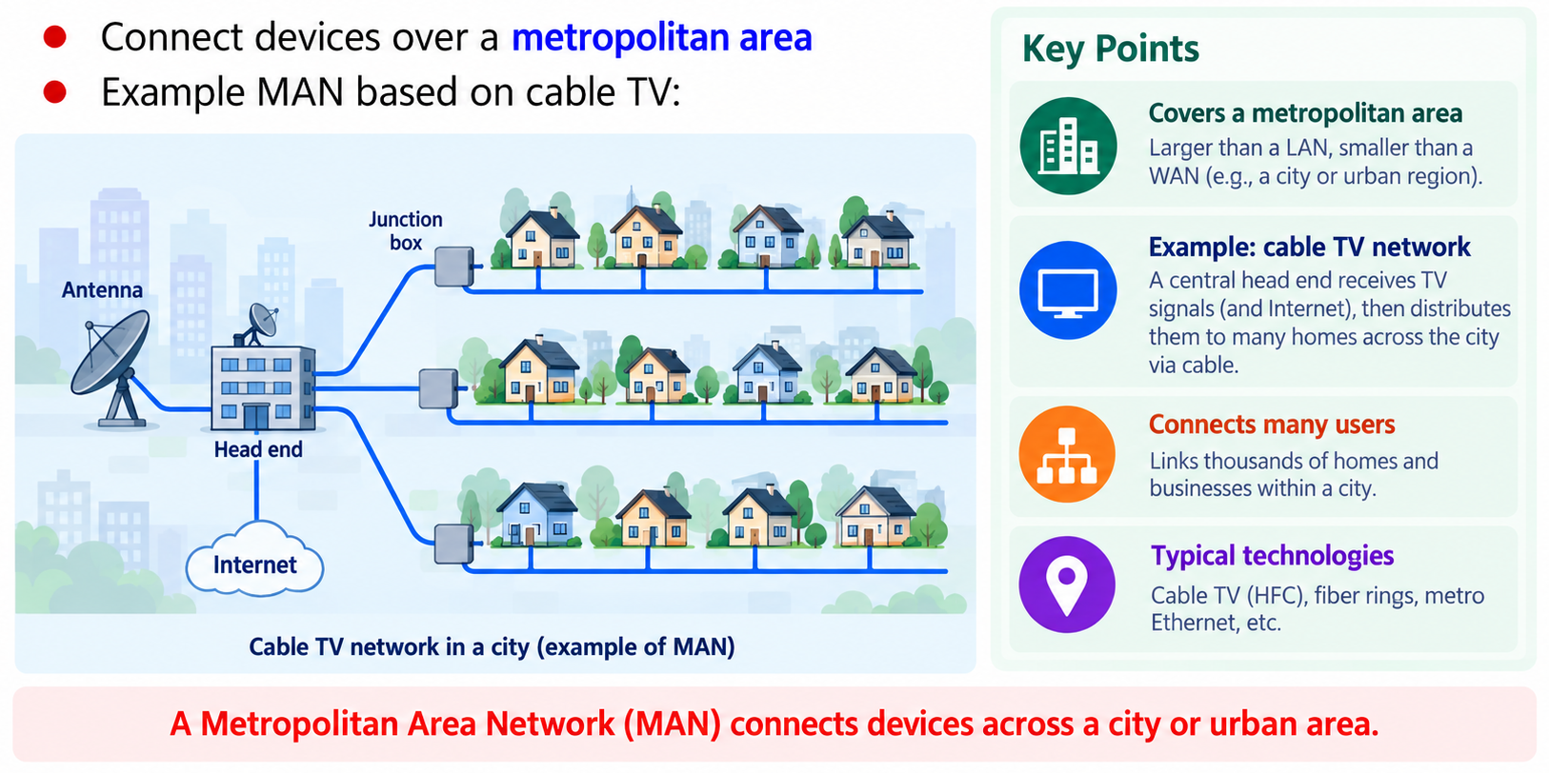
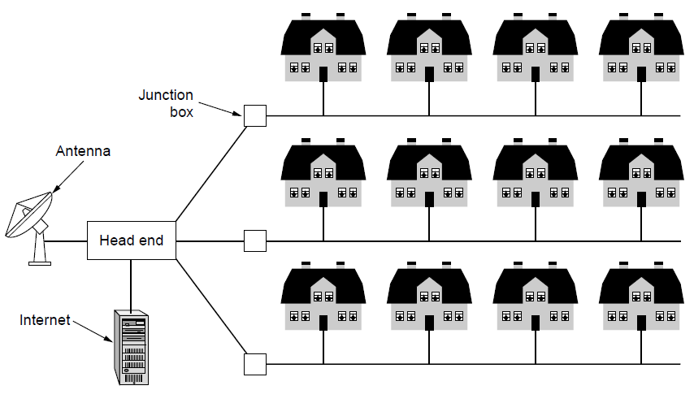
Metropolitan Area Networks
Connect devices over a metropolitan area
Example MAN based on cable TV:

Slide 48
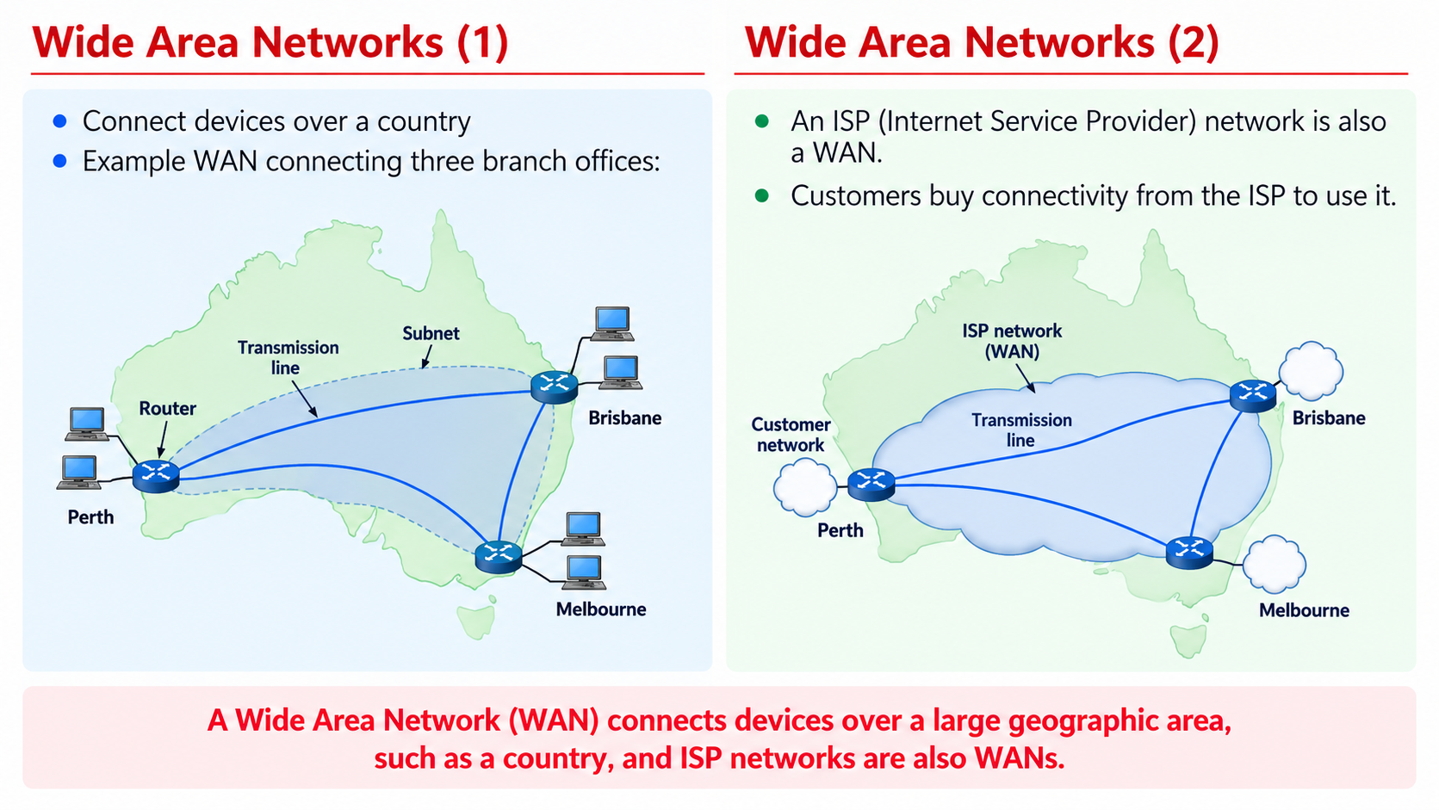
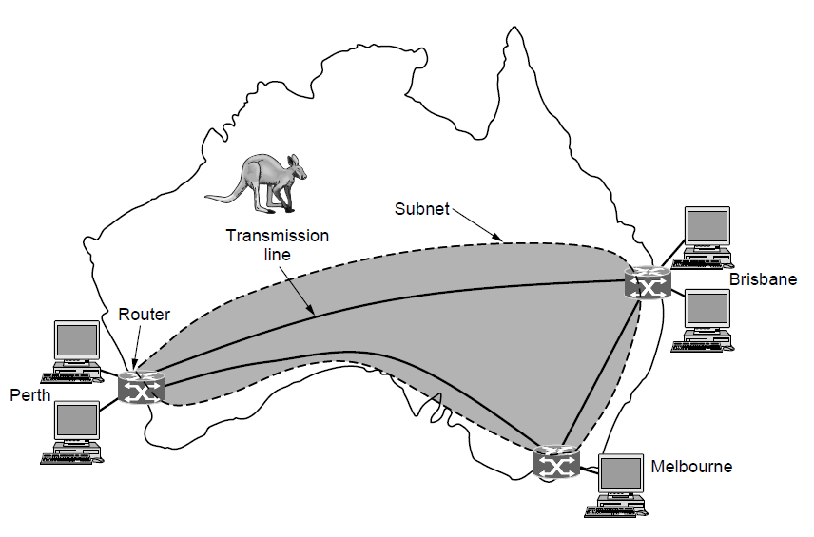
Wide Area Networks (1)
Connect devices over a country
Example WAN connecting three branch offices:

Slide 49
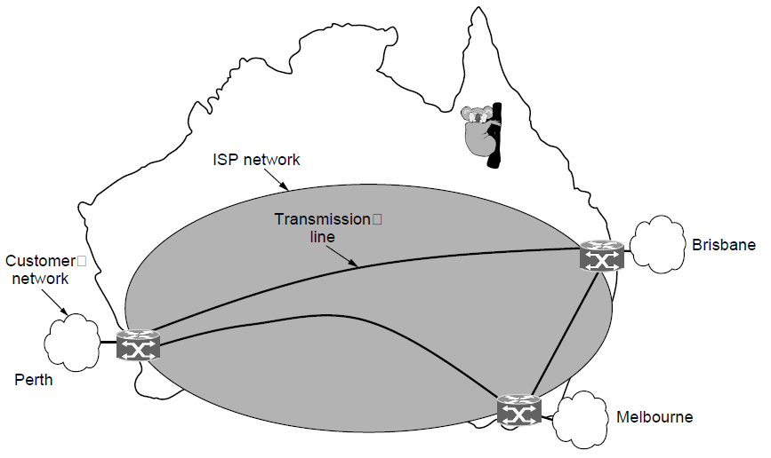
Wide Area Networks (2)
An ISP (Internet Service Provider) network is also a WAN.
Customers buy connectivity from the ISP to use it.

Slide 50
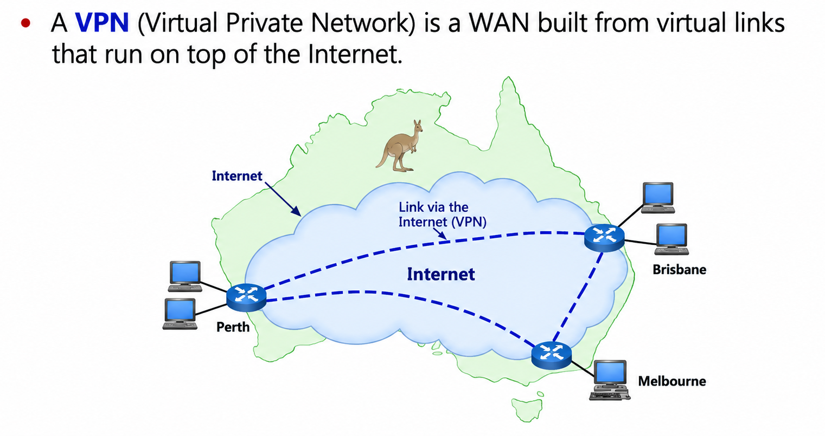
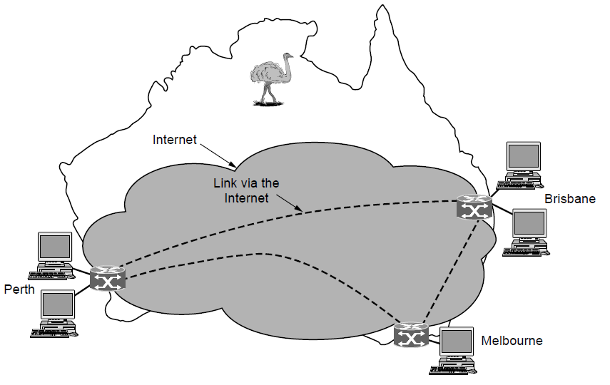
Wide Area Networks (3)
A VPN (Virtual Private Network) is a WAN built from virtual links that run on top of the Internet.

Slide 51
Chapter1：Introduction
  Uses of Computer Networks
  Network Hardware
  Network Software
  Reference Models
  Example Networks
  Network Standardization
  Metric Units

Slide 52
Network Software
  Protocol Hierarchies (协议层次) »
  Design issues for the layers »
  Connection-oriented vs. connectionless service »
  Service primitives (服务原语) »
  Relationship of services to protocols »

Slide 53
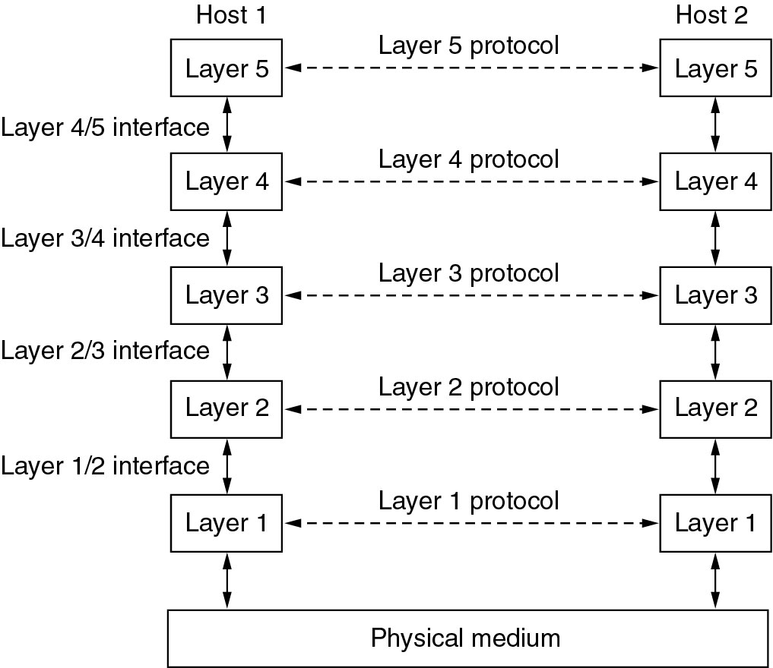
Protocol Layers (1)
Protocol layering is the main structuring method used to divide up network functionality.
Each protocol instance talks virtually to its peer (位于不同子系统的同一层的实体间的互称)
Each layer communicates only by using the one below
Lower layer services are accessed by an interface
Interface is a connection point which exchange of information between two adjacent layers.
At bottom, messages are carried by the medium
offering certain services to the layer above it.
Network Architecture: a set of layers and protocols.
Defines which primitive operations and services the lower layer makes available to the upper one.
an agreement between the communicating parties on how communication is to proceed.
Layers, protocols, and interfaces.
53

Slide 54
Protocol Layers (1)
Protocol layering is the main structuring method used to divide up network functionality.
网络的层次结构方法要解决的问题：
  网络应该具有哪些层次？每一层的功能是什么？（分层与功能）
  各层之间的关系是怎样的？它们如何进行交互？（服务与接口）
  通信双方的数据传输要遵循哪些规则？（协议）
offering certain services to the layer above it.
Network Architecture: a set of layers and protocols.
Defines which primitive operations and services the lower layer makes available to the upper one.
an agreement between the communicating parties on how communication is to proceed.
Layers, protocols, and interfaces.
54

Slide 55

Protocol Layers (2)
Example: the philosopher-translator-secretary architecture
Each protocol at different layers serves a different purpose
The common Dutch
can be replaced with another language.
Email can be used
instead of fax.

Slide 56

Protocol Layers (3)
层次化方法在其他领域的应用：邮政特快专递模型
分层的好处：
  每一层不需要知道下一层是如何实现的，只需知道层间的接口和所提供的服务
  当某一层协议发生改变时不影响上下层协议；
  结构上分开，各层可采用最合适的技术；
  易于实现和维护；
  促进标准化

Slide 57

Protocol Layers (4)
Each lower layer adds its own header (with control information) to the message to transmit and removes it on receive
Layers may also split and join messages, etc.
SDU即服务数据单元，是从高层协议来的信息单元传送到低层协议。
进入每个子层未被处理的数据称为服务数据单元(SDU)，经过子层处理后形成特定格式的数据被称为协议数据单元(PDU)。
同时，本层形成的PDU即为下一层的SDU。即第N层服务数据单元SDU，和上一层的协议数据单元（PDU）是一一对应的。
根据协议数据单元的数据的不同，送到接收端的指定层。
PDU(N) = SDU(N - 1) SDU(N) = PDU(N + 1)
水平通信/虚拟通信：对等实体进行的通信
一个SDU可能要封装在多个PDU中传输
垂直通信/实际通信：相邻层进行的通信
N层的PDU=N层PCI+N层SDU
N层的SDU=(N+1)层的PDU
  PDU由上层的服务数据单元SDU或其分段和协议控制信息PCI（Protocol Control Information）组成

Slide 58

数据单元Data Unit
服务访问点SAP（Service Access Point）：任何层间服务是在接口的SAP上进行的；每个SAP有唯一的识别地址；每个层间接口可以有多个SAP。
数据单元：在网络中信息传送的单位。
数据单元包括：
  服务数据单元 SDU：服务用户所要传递的逻辑数据单元。
  协议数据单元 PDU：不同系统对等实体为实现该层协议所交换的信息单位。 PDU=PCI+SDU
  接口数据单元 IDU：在同一系统的相邻两层实体的一次交互中，经过层间接口的信息单元。 IDU=ICI+SDU
PCI（Protocol Control Information）
ICI（Interface Control Information）
数据单元间关系

Slide 59


Example Protocol Stack

Slide 60
Merits & Defects of Protocol Hierarchies
Merit of Protocol Hierarchies (分层的优点)
  Independence of layers: These layers are relative independence.(各层之间是相对独立的)
  If any layer is changed, other layers are not affected, so far （当某一层协议发生改变时不影响上下层协议）
  as not changing interface. (灵活性好)
  Each layer can be realized in right technology.(结构上可以分割开)
  It is easy to realize and maintain. (易于实现和维护)
  Standardization (能促进标准化工作)
Defect of Protocol Hierarchies:(分层的缺点)
  Some functions may be realized reduplicatively.(功能重复实现，资源浪费)
  The number of layer is not certain.(层次数难以确定)

Slide 61
Design Issues for the Layers
Each layer solves a particular problem but must include mechanisms to address a set of recurring design issues
Issue | Example mechanisms at different layers
Reliability despite failures | Codes for error detection/correction (§3.2, 3.3) Routing around failures (§5.2)
Network growth and evolution | Addressing (§5.6) and naming (§7.1) Protocol layering (§1.3)
Allocation of resources like bandwidth | Multiple access (§4.2) Congestion control (§5.3, 6.3)
Security against various threats | Confidentiality of messages (§8.2, 8.6) Authentication of communicating parties (§8.7)

Slide 62

Connection-Oriented vs. Connectionless
Service provided by a layer may be kinds of either:
  Connection-oriented, must be set up for ongoing use (and torn down after use), e.g., phone call
  Connectionless, messages are handled separately, e.g., postal delivery
面向连接的服务：建立连接（需要协商）、保持顺序。但是ACK过程会引入额外开销和时延。
无连接的服务：不建连，不可靠，每个包独立进行路由选择，可能走不同的路径到达顺序可能不同，顺序性差。
可靠：有确认和丢失处理
不可靠：无确认，发送完就结束
Qos：时延、抖动、传输时间、丢包率……
TCP (Transmission Control Protocol) is a connection-oriented transport protocol providing a reliable bytesteam service at the Transport layer, while UDP (User Datagram Protocol) is a connectionless network protocol. Both operate over IP.
IP provides unreliable datagram service at the Network layer.
More examples: RTP (used to carry VoIP data) provides unreliable connection service;

Slide 63
Number of Layers?
若层数太少，就会使每一层的协议太复杂；
若层数太多，又会在描述和综合各层功能的系统工程任务时遇到较多的困难，实现复杂。
主流：OSI 七层模型和TCP/IP 四层模型

Slide 64

网络体系结构的基本概念

Slide 65

网络体系结构的基本概念

Slide 66

网络体系结构的基本概念

Slide 67

网络体系结构的基本概念

Slide 68

网络体系结构的基本概念

Slide 69

Service Primitives (1)
A service is provided to the layer above as primitives. 服务在形式上是由一组接口原语（或操作）来描述的。
Each protocol which communicates in a layered architecture (e.g. based on the OSI Reference Model) communicates in a peer-to-peer manner with its remote protocol entity. Communication between adjacent protocol layers (i.e. within the same communications node) are managed by calling functions, called primitives, between the layers.
The primitives are called at the client and server by the higher layer using the service.
Hypothetical example of service primitives that may provide a reliable byte stream (connection-oriented) service:

Slide 70

Service Primitives (2)
Hypothetical example of how these primitives may be used for a client-server interaction
Client
Server
LISTEN (0)
CONNECT (1)
Connect request
ACCEPT
(2)
Accept response
RECEIVE
SEND
Request for data
RECEIVE
(3)
SEND (4)
Reply
DISCONNECT (5)
Disconnect
DISCONNECT (6)
Disconnect

Slide 71


Relationship of Services to Protocols
Recap:
  A layer provides a service to the one above [vertical]
  A layer talks to its peer using a protocol [horizontal]
Service: a set of primitives (operations) that a layer provides to the layer above it; it defines what operations the layer is prepared to perform on behalf of its users, but it says nothing at all about how these operations are implemented.
Protocol, is a set of rules governing the format and meaning of the frames, packets, or messages that are exchanged by the peer entities within a layer.
可以自由地改变协议，但不能改变服务，因为这些服务对于它们的用户是可见的，是提供给用户使用的。

Slide 72



Principles of Layered Network Architecture
“通信”。

Slide 73
Reference Models
Reference models describe the layers in a network architecture
  OSI reference model »
  TCP/IP reference model »
  Model used for this text »
  Critique of OSI and TCP/IP »

Slide 74

OSI Reference Model
A principled, international standard, seven layer model to connect different systems
*PDU：*Protocol Data Unit

Slide 75

TCP/IP Reference Model
A four layer model derived from experimentation; omits some OSI layers and uses the IP as the network layer.
IP is the “narrow waist” of the Internet
Protocols are shown in their respective layers

Slide 76

The TCP/IP Model vs. OSI

Slide 77

Hybrid Model Used in this Book
It is based on the TCP/IP model but we include the physical layer and look beyond Internet protocols.
The hybrid reference model to be used in this book.

Slide 78


Hybrid Model: Physical Layer

Slide 79


Hybrid Model: Data Link Layer

Slide 80



Hybrid Model: Network Layer

Slide 81



Hybrid Model: Transport Layer

Slide 82

Hybrid Model: Application Layer

Slide 83

Host 1 sending data to Host 2

Slide 84

Host 1 sending data to Host 2
从层次上来看数据的流动
路由器在转发分组时最高只用到网络层，而没有使用运输层和应用层

Slide 85
Critique of OSI & TCP/IP
OSI:
    Very influential model with clear concepts
    Models, protocols and adoption all bogged down by politics and complexity
      Bad timing: OSI提出时，TCP/IP已经被研究机构和大学广泛使用，并有很成熟的应用。生产商和公司不愿再投资支持第二种协议栈；
      Bad technology: 对比TCP/IP，OSI有应用层、表示层、会话层。但是，表示层、会话层对应的协议非常少，而且本身7层分的不是很均匀。层数的增多增加了理解和实现的难度。
      Bad implementation: OSI层数更多，设计更复杂，效率低下，并且出现的较晚，导致其初期的实现代价比较高，而且质量很差。
      Bad politics: OSI早期有欧美政府参与推广，包括european telecommunication ministries 、 European community、US Gov。政府部门强推这种质量很差的技术，引起了欧美从事网络的技术人员和科研人员的强烈反感和抵触。
TCP/IP:
    Very successful protocols that worked well and thrived
    Weak model derived after the fact from protocols
      Not general: 不适用于描述其他非TCP/IP的协议栈，比如Bluetooth。

Slide 86
Example Networks
  The Internet »
  3G mobile phone networks »
  Wireless LANs »
  RFID and sensor networks »

Slide 87



Internet (1)
Before the Internet was the ARPANET (20世纪50年代末由美国国防部高级研究计划局（ARPA）主持研制的), a decentralized, packet-switched network based on Baran’s ideas.
ARPANET于1969年正式启用，当时仅连接了4台计算机，供科学家们进行计算机联网实验用，这就是因特网的前身。
到70年代，ARPAnet已经有了好几十个计算机网络，但是每个网络只能在网络内部的计算机之间互联通信，不同计算机网络之间仍然不能互通。为此， ARPA又设立了新的研究项目，支持学术界和工业界进行有关的研究，研究的主要内容就是想用一种新的方法将不同的计算机局域网互联，形成“互联网”。研究人员称之为“internetwork”，简称“Internet”，这个名词就一直沿用到现在。
1974年，出现了连接分组网络的协议（Pioneered by Vint Cerf & Bob Kahn，互联网之父），后续演变为了TCP/IP。ARPA在1982年接受了TCP/IP，选定Internet为主要的计算机通信系统，并把其它的军用计算机网络都转换到TCP/IP。
ARPANET topology in 1969.
Nodes are IMPs, or early routers, linked to hosts
56 kbps links
ARPANET topology in Sept 1972.

Slide 88

Internet (2)
The early Internet used NSFnet (1985-1995) as its backbone; universities connected to get on the Internet
  1986年，美国国家科学基金组织（NSF）将分布在美国各地的5个为科研教育服务的超级计算机中心互联，并支持地区网络，形成NSFnet。
  1988 年，NSFnet替代ARPAnet成为Internet的主干网。NSFnet主干网利用了在ARPAnet中已证明是非常成功的TCP/IP技术，准许各大学、政府或私人科研机构的网络加入。
  1989年，ARPAnet解散，Internet从军用转向民用。
  1995年4月30日，NSFnet正式宣布停止运作。而此时Internet的骨干网已经覆盖了全球91个国家，主机已超过400万台。
1.5 Mbps links
NSFNET topology in 1988

Slide 89
Internet (3)
The modern Internet is more complex:
  ISP networks serve as the Internet backbone
  ISPs connect or peer to exchange traffic at IXPs
  Within each network routers switch packets
  Between networks, traffic exchange is set by business agreements
  Customers connect at the edge by many means
    Cable, DSL, Fiber-to-the-Home, 3G/4G wireless, dialup
  Data centers concentrate many servers (“the cloud”)
  Most traffic is content from data centers (esp. video)
  The architecture continues to evolve

Slide 90


Internet (4)
Architecture of the Internet

Slide 91

3G Mobile Phone Networks (1)
3G network is based on spatial cells; each cell provides wireless service to mobiles within it via a base station

Slide 92

3G Mobile Phone Networks (2)
Base stations connect to the core network to find other mobiles and send data to the phone network and Internet

Slide 93

3G Mobile Phone Networks (3)
As mobiles move, base stations hand them off from one cell to the next, and the network tracks their location
Handover

Slide 94

Wireless LANs（1）
In 802.11, clients communicate via an AP (Access Point) that is wired to the rest of the network.

Slide 95

Wireless LANs（2）
Signals in the 2.4GHz ISM band vary in strength due to many effects, such as multipath fading due to reflections
  requires complex transmission schemes, e.g., OFDM

Slide 96

Wireless LANs（3）
Radio broadcasts interfere with each other, and radio ranges may incompletely overlap
  CSMA (Carrier Sense Multiple Access 载波监听多路访问) designs are used

Slide 97

RFID and Sensor Networks (1)
Passive UHF RFID（无源 特高频 射频识别） networks everyday objects:
  Tags (stickers with not even a battery) are placed on objects
  Readers send signals that the tags reflect to communicate

Slide 98

RFID and Sensor Networks (2)
Sensor networks spread small devices over an area:
  Devices send sensed data to collector via wireless hops

Slide 99
Network Standardization
  Standards define what is needed for interoperability
  Some of the many standards bodies:
Body | Area | Examples | Notes
ITU | Telecommunications | G.992, ADSL H.264, MPEG4 | 国际电信联盟，是联合国的一个重要专门机构，也是联合国机构中历史最长的一个国际组织
IEEE | Communications | 802.3, Ethernet 802.11, WiFi | 电气和电子工程师协会，是一个美国的电子技术与信息科学工程师的协会，是世界上最大的非营利性专业技术学会，其会员人数超过40万人，遍布160多个国家
IETF | Internet | RFC 2616, HTTP/1.1 RFC 1034/1035, DNS | 互联网工程任务组，成立于1985年底，是全球互联网最具权威的技术标准化组织，主要任务是负责互联网相关技术规范的研发和制定，当前绝大多数国际互联网技术标准出自IETF
W3C | Web | HTML5 standard CSS standard | World Wide Web Consortium，万维网联盟，创建于1994年，是Web技术领域最具权威和影响力的国际中立性技术标准机构

Slide 100

IEEE 802 Standards
The 802 working groups. The important ones are marked with *. The ones marked with ↓ are hibernating(休眠). The one marked with † gave up.

Slide 101

Metric Units
The main prefixes we use:
  Use powers of 10 for rates, powers of 2 for storage
    E.g., 1 Mbps = 1,000,000 bps, 1 KB = 1024 bytes
  “B” is for bytes, “b” is for bits

Slide 102
Selected Problems
    P1. Imagine that you have trained your St. Bernard, Bernie, to carry a box of three 8-mm tapes instead of a flask of brandy. (When your disk fills up, you consider that an emergency.) These tapes each contain 7 gigabytes. The dog can travel to your side, wherever you may be, at 18 km/hour. For what range of distances does Bernie have a higher data rate than a transmission line whose data rate (excluding overhead) is 150 Mbps?
Ans:.
    P2. A client-server system uses a satellite network, with the satellite at a height of 40,000 km. What is the best-case delay in response to a request?
Ans:
    P3. What are two reasons for using layered protocols? What is one possible disadvantage of using layered protocols?
Ans:
    P4. What is the main difference between TCP and UDP?
Ans:

Slide 103
Selected Problems
    P5. When a file is transferred between two computers, two acknowledgement strategies are possible. In the first one, the file is chopped up into packets, which are individually acknowledged by the receiver, but the file transfer as a whole is not acknowledged. In the second one, the packets are not acknowledged individually, but the entire file is acknowledged when it arrives. Discuss these two approaches.
Ans:
    P6. A system has an n-layer protocol hierarchy. Applications generate messages of length M bytes. At each of the layers, an h-byte header is added. What fraction of the network bandwidth is filled with headers?
Ans:

Slide 104

End
Chapter 1

